Slide 1
VPDoR Finance
Travel Booking Policy Update
January 2024

Slide 2
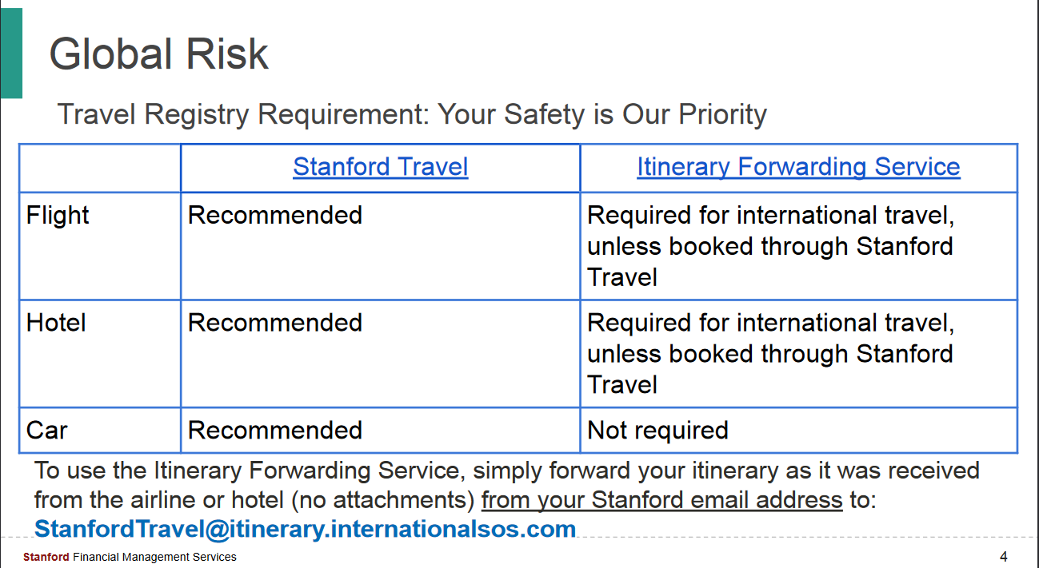
Highly recommended for VPDoR
Notes:
Individuals traveling on university business are expected to use transportation options that are necessary and reasonable. The university pays for reasonable and necessary airfare along with certain fees and charges

Slide 3
Benefits for travel booked through the Stanford Travel booking channels:
Automatically send reservations to the travel registry to enable the university to provide assistance to travelers in the event of an emergency
Access to priority boarding, name changes, and other advantages negotiated with Stanford's travel suppliers and partners
Stanford-negotiated discounts with all major airlines and Enterprise/National and Hertz car rental companies, and low rates at thousands of hotels around the world
Convenience of booking the majority of university travel in one place
Simplified expense reimbursement process
Eligibility for applicable supplier loyalty points and benefits
Pay with the Stanford Travel Card or a personal card
Booking channel support provided by industry experts to assist at every step of the journey

Slide 4
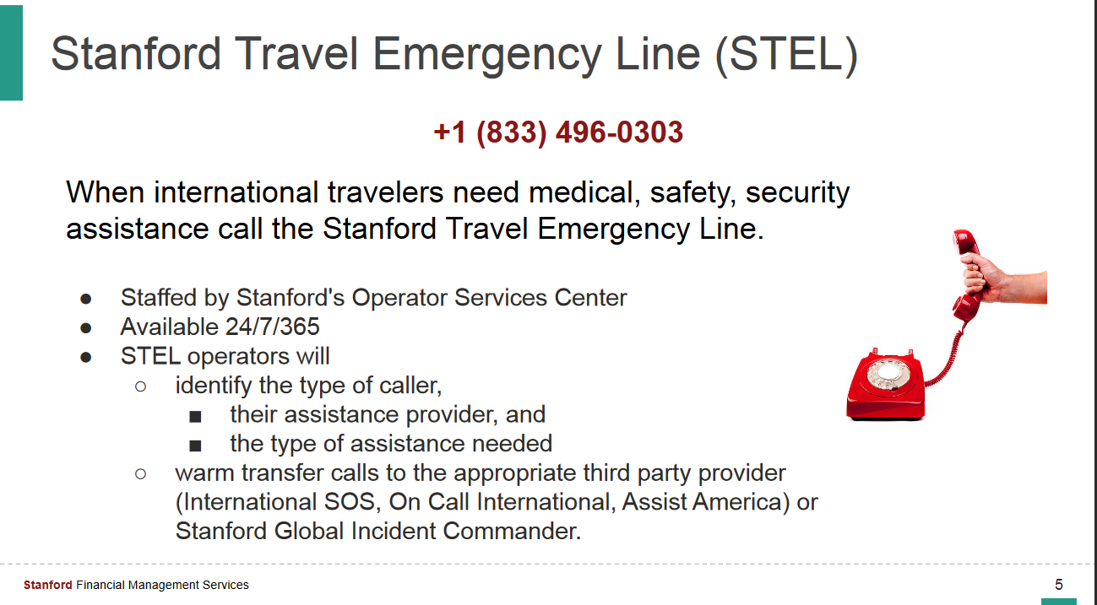

Slide 5
Where to find more details
Individuals traveling on university business are expected to use transportation options that are necessary and reasonable.
The requirements of the new policy are available in detail on Fingate’s Business and Travel Expense Policies page.
Registration with the Travel Registry (via International SOS) can be done by forwarding your flight and hotel itineraries to StanfordTravel@itinerary.internationalsos.com.
Detailed instructions are provided on the International Affairs website.

