Slide 1
VPDoR FY25 Budget Plan
Process video recording
February 13, 2024

Slide 2

Topics
  Process and Timeline
  Resources
  Quick Guide
  Q&A
  Additional Information (reference material)

Slide 3
Process and Timeline

Slide 4
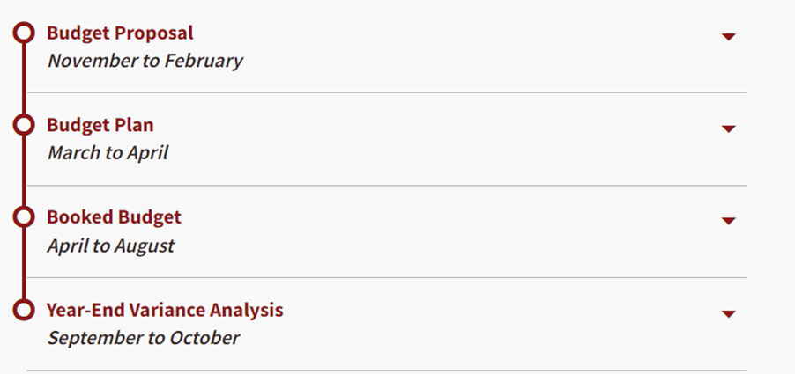

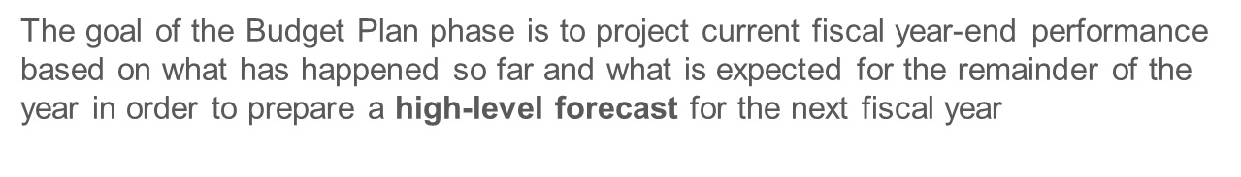
Stanford Annual Budget Cycle

Slide 5
Budget Plan Process timeline
Feb 13: Q&A Session
Feb 15: Provide organization preference
Feb: Planning preparation (review TAS data)
Review sessions with Dean’s Office:
1) Overall Assumptions
2) Variance Analysis (FY24 YEP vs. BB, FY25 vs. FY24)
Mar 1: BP Module opens for unit input
Mar 21: Complete YEP and Budget Plan inputs and headcount template
Unit
Feb Preparation
Mar 1 -21
Budget Input
Mar 22-27
Variance Reporting
April
Submission
Dean’s Finance
Provide information and support to units: TAS, org preference, training, etc.
Provide one-to-one support to units
Set up the review sessions
Apr 5: Budget Plan with narrative due to UBO

Slide 6

Training and Support
Training course in STARS (UBO-2000-WEB)
Keep this deck as reference (quick guide attached)
Reach out to your finance contact or via Slack group: vpdor-finance-units-connect
Video recording from the prior year

Slide 7
True or False (put your answer in chat)
I must do a bottoms-up budget by PTA to prepare for the budget plan
FALSE – The goal is to develop a high-level budget. Planning can be done at fund type (operating, designated, etc.) level.

Slide 8
Quick Guide

Slide 9
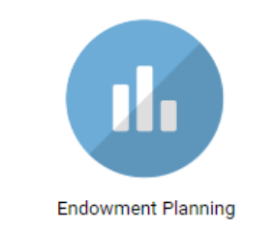
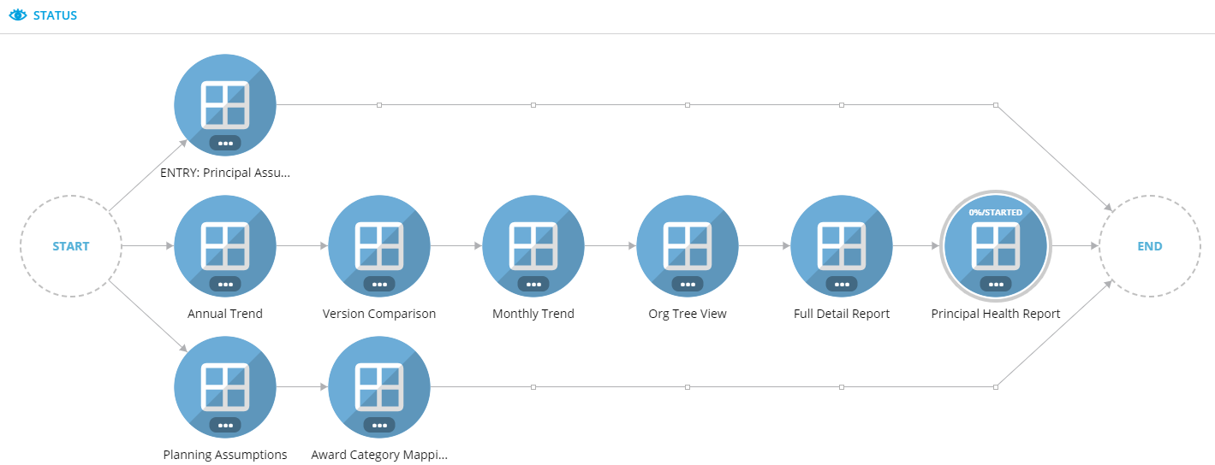
Step 1. Endowment Planning Module (due Mar 8)
2. Modify Principal (Addition / Reduction)
Various Reporting Options
1. Evaluate Annual Principal growth
Same process as booked budget
* Skip this step with no change in Endowment Principal assumptions

Slide 10
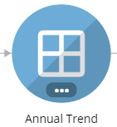
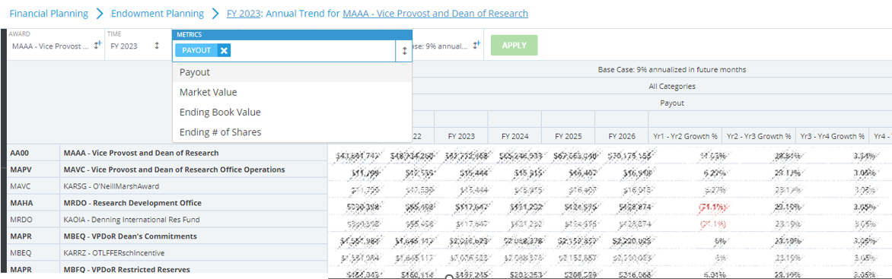
Step 1.1 Endowment Planning Module (due Mar 8)
Default to PAYOUT, with other metrics available to be included to the report

Slide 11
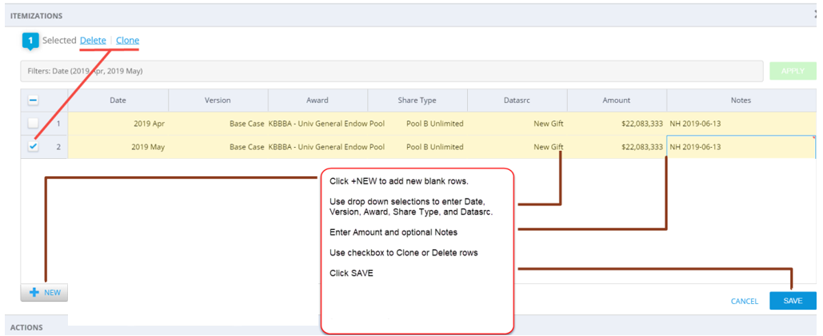
Step 1.2 Endowment Planning Module (due Mar 8)
Click “Itemization on the left menu bar to start the process
Create new entry using + NEW button on the lower left-hand corner
Incorporate all the changes anticipated.
Calculation will be done overnight, check your result at [Endowment Planning] the following day

Slide 12
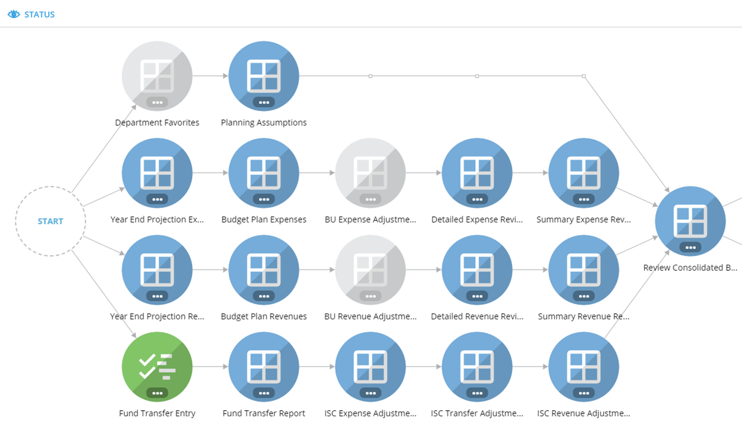
Budget Plan Module
Planning Assumptions updated by UBO
Step 2
Step 6
Step 5
Step 3
Step 7
Step 4

Slide 13

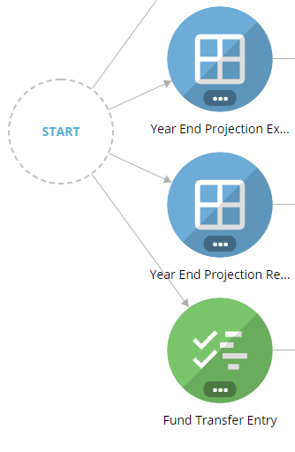
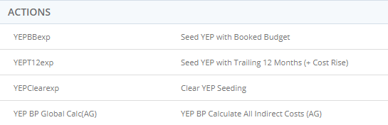
Step 2. Input FY24 YEP- Expense
Update FY24YEP with one option under Action :
YEPBBexp Seed with Booked Budget
YEPT12exp* Seed YEP with Trailing 12 months (+ Cost Rises)
OR
Direct data input
*Non-Salary cost rises can be changed under Planning Assumptions panel.
Alternatively, you can choose to adjust the projection in the Year End Projection Expense Panel with a flat number or %.
Global Calc (ISC, IDC and Fringe) runs in the background every 2 hours.
OR update manually via Actions. To run Global Cal manually, click on the xx icon on the left menu bar, choose the last item on the list to process.
Global Cals: Fringe(RBE, PostDocs, Contingent, TA&RA), Grad Stipend Health Surcharge, Tuition Grant Program, Indirect Cost (IDC), Sponsored Revenue, Infrastructure Charge (ISC), (Revenue, Expense, Transfer) and Budget Plan Beginning Balance

Slide 14
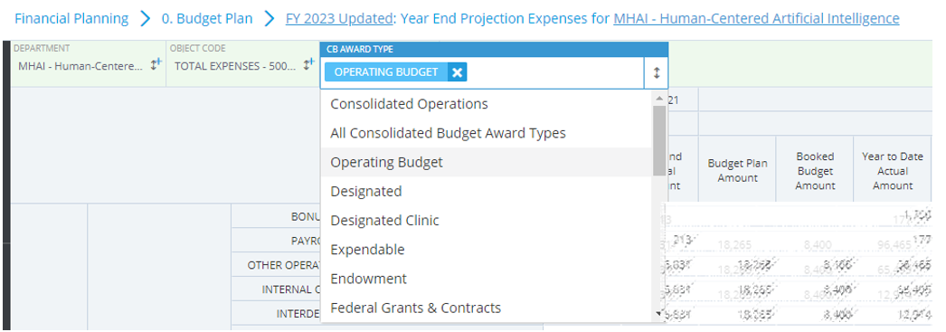
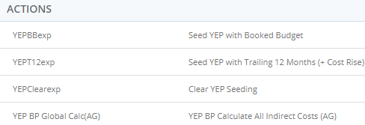
Step 2.1 Input FY24 YEP- Expense
← Data Input is required for by award type
Seed the initial projection with one of these options. Make additional adjustment if needed under [Adjustment %] or [Adjustment Amount] column.

Slide 15
Step 3. Input FY24 YEP- Revenue
Update FY24YEP with one of the seeding options:
YEPBBrev Seed with Booked Budget
YEPT12rev Seed YEP with Trailing 12 months
OR
Direct data input
You also have a choice to adjust the projection with a flat number or %. Global Calc (ISC, IDC and Fringe) will be run in the background every 2 hours. It can be updated manually. (See FY24 YEP Expense tab)
Similar to Expense entry, data input is required to be done by award type.

Slide 16

Quick Q&A

Slide 17

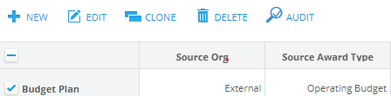
Step 4. Transfer Fund Entry- FY24 YEP
This panel is used to record internal transfers between award types or from transfer coming from an external source (different school)
Click + NEW to create a new entry and filled in all the fields and provide description with Scenario = “Year End Projection”
To continue with a similar entry, use the CLONE feature by checking a previously created entry. The new entry will show on the top of your screen for edit. For example, an entry was set for Year End Projection, create a similar one for Budget Plan

Slide 18
Step 4.1. Transfer Fund Type
Operating Transfers:
Funds moved between Award Type within a department to cover Operating Expenses
Interunit Fund Appropriations:
Award owned by one organization and Task on the same Award but owned by a different org
Asset Transfer:
Funds moved to/from Plant or Endowment Principal Assets
Base General Fund:
Annual General Fund allocation (where applicable)
TAS entries:
Fund support from Provost or President office
Type of Transfers to be recorded in [Fund Transfer Entry] panel
To be loaded by Dean office or UBO

Slide 19
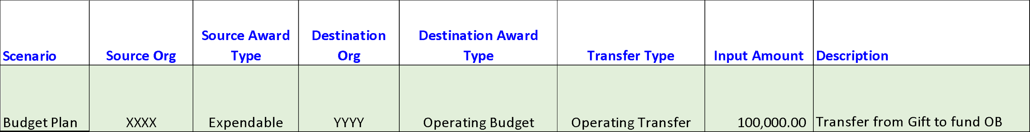
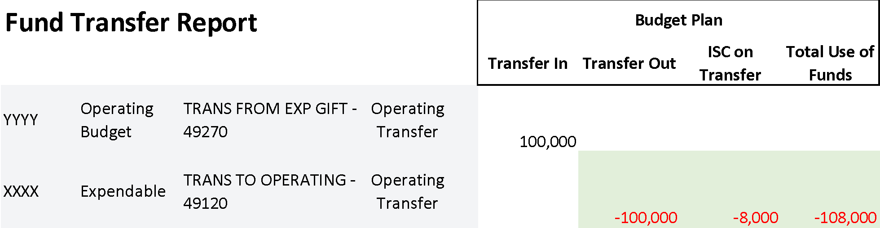
Step 4.2 Transfer Fund – Infrastructure Charges
Infrastructure Charges (ISC) incurs when Funds are transferred OUT from Expendable or Endowment
Infrastructure Charges (ISC) will be calculated by the system

Slide 20
True or False (put your answer in chat)
I need to input all fund transfers myself
FALSE – Base general fund allocation (FY24 and 25), and president provost funds (TAS) will be loaded for all units.

Slide 21
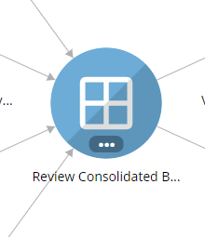
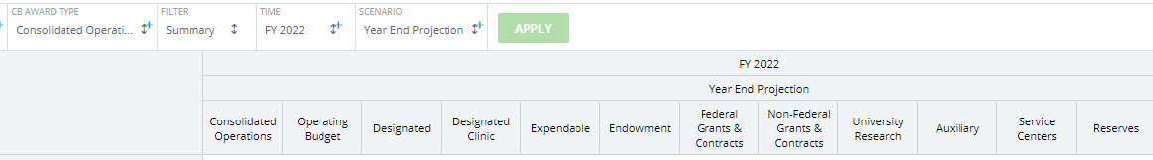
Step 5. Review Consolidated Budget
Modify the TIME and SCENARIO to reflect FY2024 Year End Projection to review your update
Review expenses and revenue by award type and fine tune any of these panels as needed:
FY24 YEP Expense
FY24 YEP Revenue
Fund Transfers panel
Save your changes reflect your assumption(s)
Operating Budget fund balance is ZERO and no deficits in any award types.

Slide 22
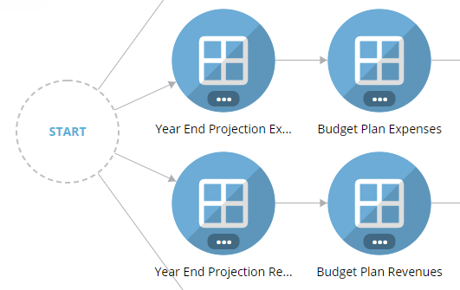
Step 6. FY25 BP- Input Expense
Update FY25 BP with one of the seeding options:
BPYEPexp Seed BP with PY YEP + Cost Rise
BPBBexp Seed BP with PY Booked Budget + Cost Rise
OR
Direct data input
Enter adjustment % or $ in the light-yellow cells to allow further adjustment after seeding to reach to the best estimate to each categories by award type.
Global Calc (ISC, IDC and Fringe) will be run in the background every 2 hours, or can be done as manual refresh under Action

Slide 23
Step 7. FY25 BP- Revenue
Update FY25 BP with one of the options:
BPYEPrev Seed BP with PY YEP
BPBBrev Seed BP with PY Booked Budget
OR
Direct data input
Enter adjustment % or $ in the light-yellow cells to allow further adjustment after seeding to reach to the best estimate to all categories by award type.
Global Calc (ISC, IDC and Fringe) will be run in the background every 2 hours, or can be done as manual refresh under Action

Slide 24
Step 8. Transfer Fund Entry- FY25 BP
Refer to Step 4, slide 18-20
Choose scenario = “Budget Plan” for each entry.
Utilize [clone] feature to duplicate and modify entries.

Slide 25
Step 9. Review Consolidated Budget for FY25 Budget Plan
Refer to Step 5, slide 22
Modify the TIME and SCENARIO to reflect FY2025 Budget Plan to review your update
Review expenses and revenue by award type and fine tune any of these panels as needed:
FY25 Budget Plan Expense
FY25 Budget Plan Revenue
Fund Transfers panel
Save your changes reflect your assumption(s)
Operating Budget fund balance is ZERO and no deficits in any award types.

Slide 26
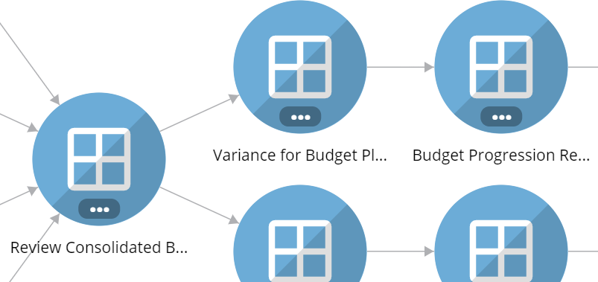
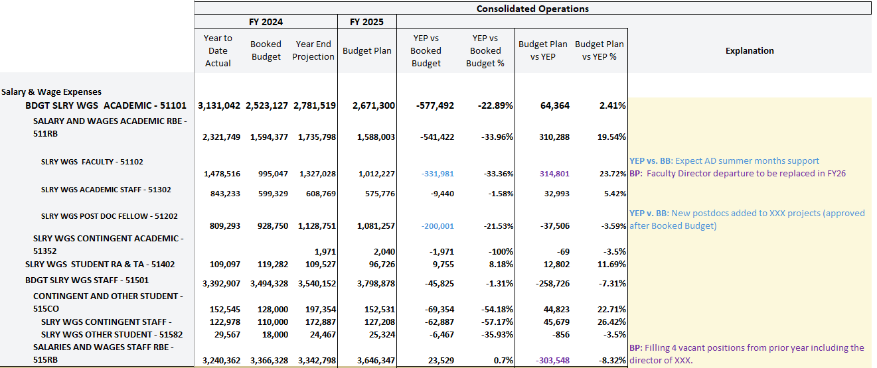
Variance Write up
Review 1) Budget Progression Report and 2) Variance for Budget Plan Report
Provide an explanation any variance over $200K at line level (Consolidated Operations) at the Department level for
FY24 YEP vs. FY24 BB or
FY25 BP vs. FY24 YEP
Focus on programmatic drivers
Notes:
Give an example of how to capture two sets of variances, and a reminder to comment about programmatic drivers

Slide 27
Headcount Growth Table

Slide 28

  Crossing the Finish Line
After all inputs are done, review YEP and budget plan. Ensure:
Capture your Budget Plan assumptions
Revenue, expenses and transfers look reasonable
Operating budget ending balance = ZERO. No deficit on any award type
Utilize various reports to view trending
Update comments in Variance Report prior to meeting with VPDoR finance team.
Any questions or comment, please reach out to your finance liaison.
Note: Tidemark has scheduled downtimes (to be announced)

Slide 29

Your Questions, Answered

Slide 30
Additional Information
Process illustrations for various steps in the budget plan process

Slide 31
Preliminary Planning Assumptions

Slide 32

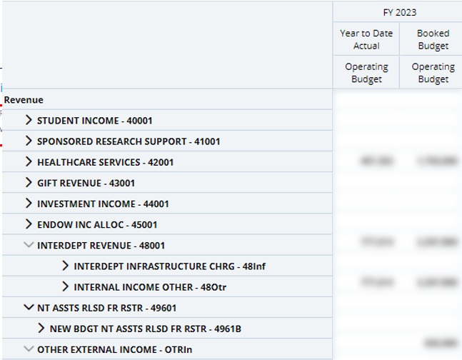
  Plan your numbers
201 report. Award Type, (Operating Budget, Designated, for example);
Time = FY2024, and Scenario = Booked Budget and FY24 YTD Actual
The view can be served as a starting point of Year End Projection (YEP)
Repeat for all Award Types

Slide 33
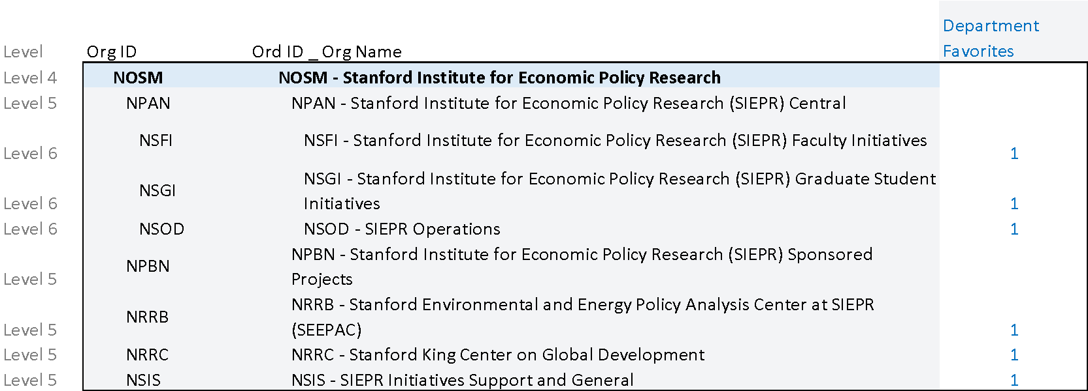
Set Department Favorite (due Feb 15)
This process is managed by the Dean office.
Select departments you wish to budget for the Year End Projection (YEP) and Budget Plan (BP) data input. This can be at the Budget Unit level, or at lower-level orgs depending on your preferred level of granularity
It can be done as a combination with unit A set for data entry at level 6 and other at level 5 (less details)
Rule: when planning on a parent level org, you cannot also plan at children of that parent and vice versa

Slide 34
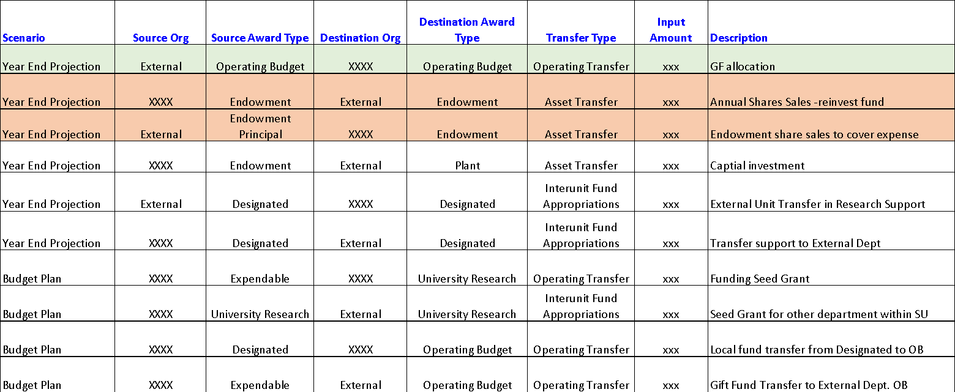
Transfer Fund Entry examples
Fund Transfer process is required for both Year End Projection (YEP) and Budget Plan (BP)
External refers to an organization outside your department
Reflect the reduction of principal in [Endowment Planning] module

Slide 35
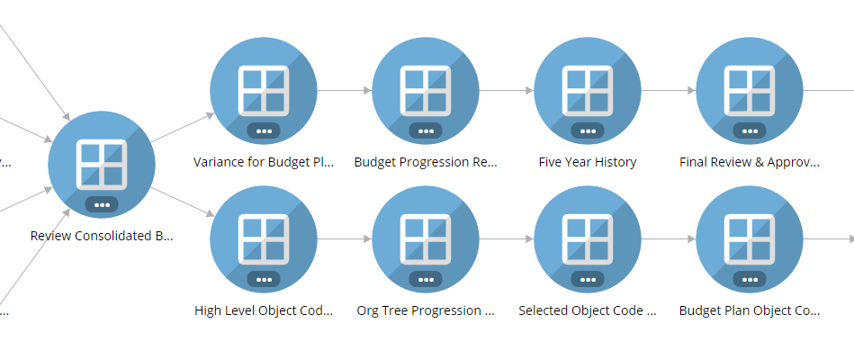
Useful reports for review
* FY24 YEP vs BB & FY25 BP vs FY24 YEP. Use the comment section to capture major variance.
Progression of all scenario (BP, BB,YEP, YEA) in the budget cycle for the last 3 years.
Five Years comparison of any scenario for trending. Drill down capability available.
FY22-24 data at consolidated level + FY25 BP by award type
High level checking after data input. Default to FY2025 Budget Plan scenario
High level report showing Revenue, Operating Transfer, Total Expenses, etc. for both FY24 YEP and FY25 BP
Variance displays at Org level (goes down to level 5/6/7 as applicable)
Like “High Level Object Code”, report can be filtered by object code at Org Level
Details behind each Object code by Award Type for Budget Plan Booked Budget and/or YTD Actual (if applicable).
* Input major variance in explanation column on [Variance for Budget Plan] report (at Consolidated view) prior to review session with the Dean’s Office

Slide 36

Q&A
The key to successful execution:
Preparation ahead of March 1

