Slide 1
VPDoR Finance
Update
April 2024

Slide 2
Topics
FY25 budget context and updated planning assumptions
New iJournals authority and required training
Change PTA for PO’s
Stanford travel local hotel program
New Fingate learning resources
Coming Up – Cardinal Planning & Budgeting System Update

Slide 3
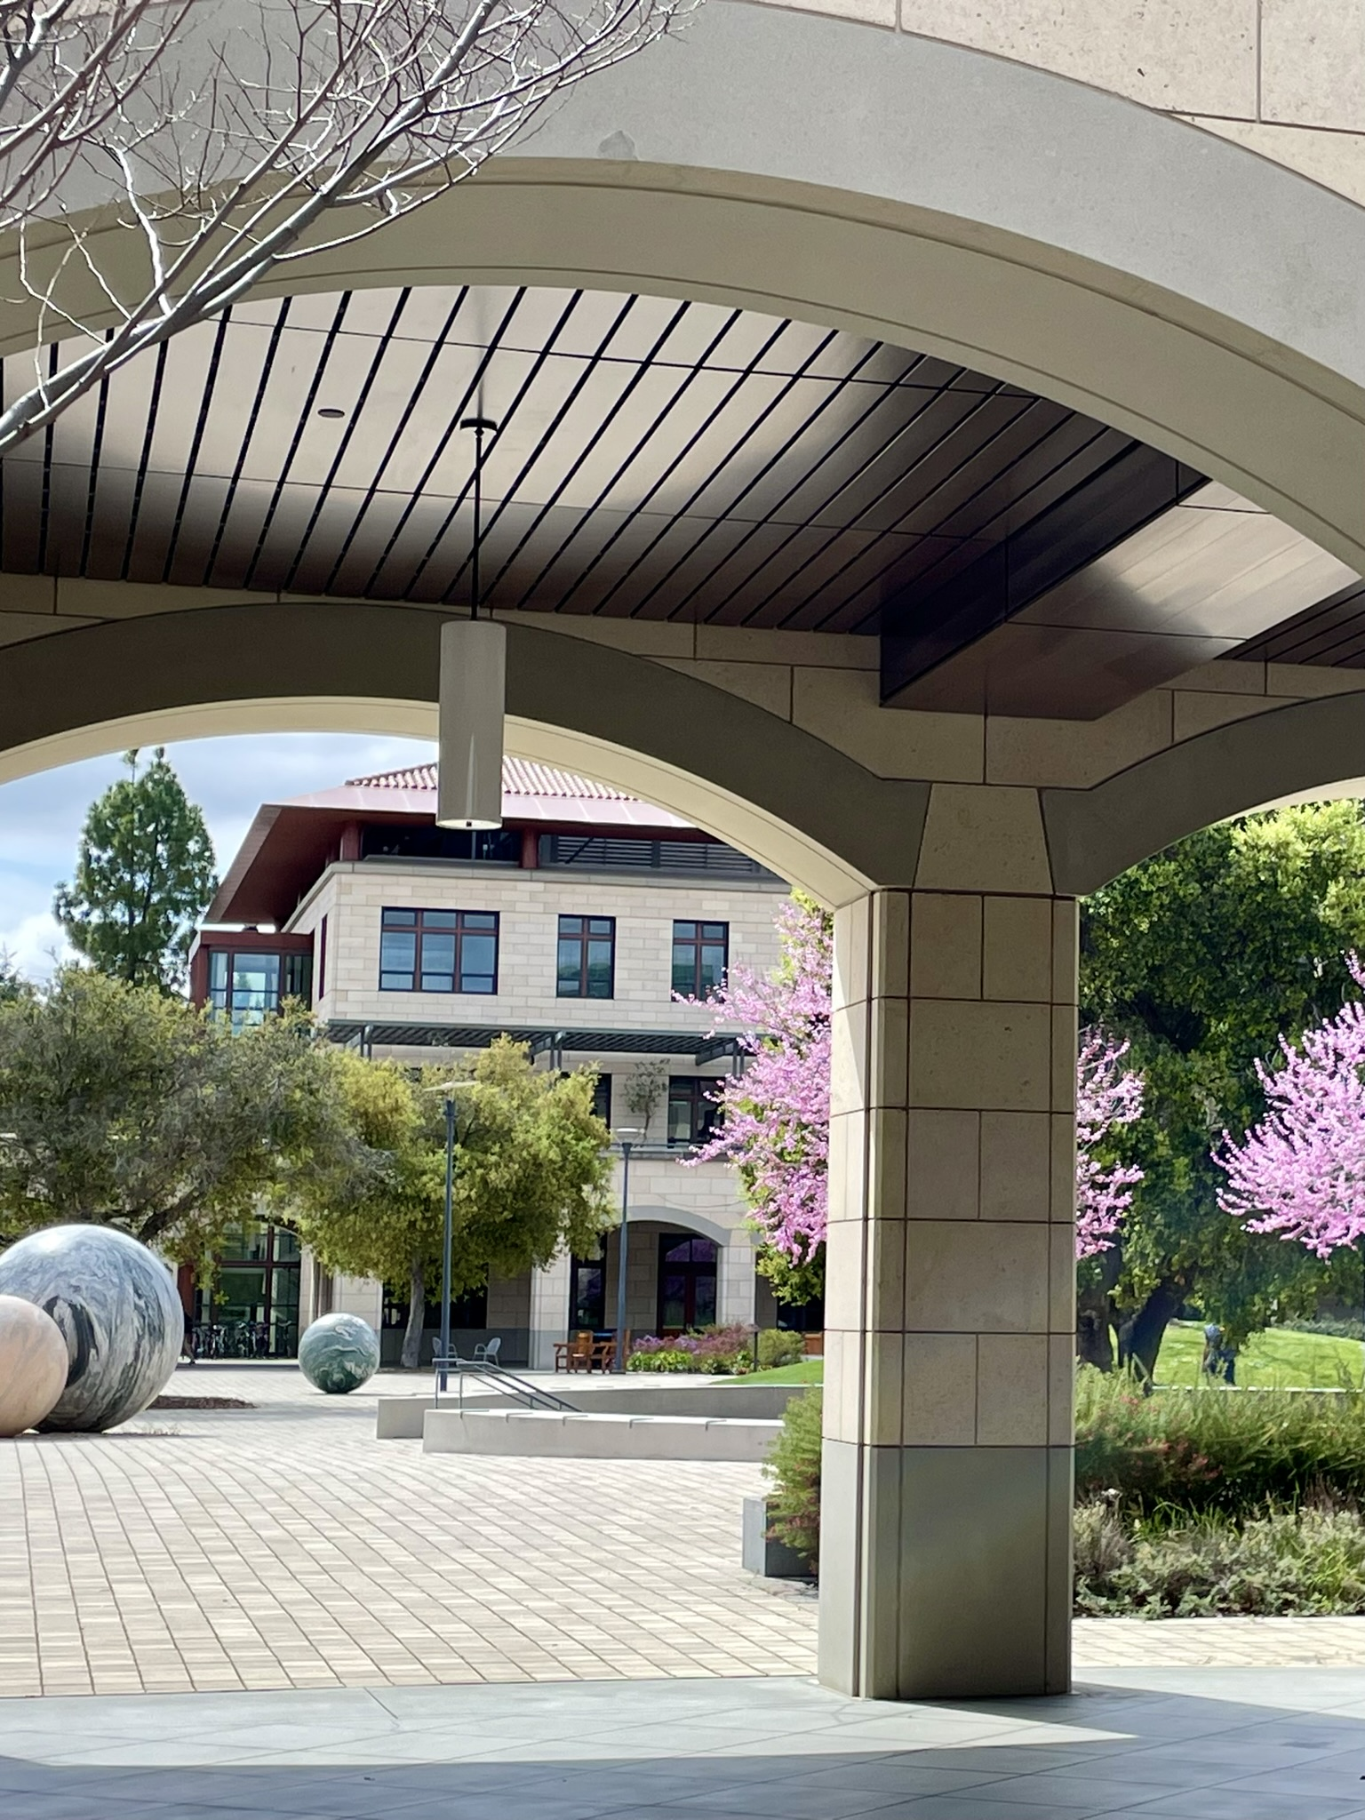

Thank you for completing the budget plan on time!

Slide 4
Planning Context
Moderating inflation
Continued operational shortfalls in auxiliary units
Significant requirements for infrastructure

Slide 5
Priority for FY25 General Funds/Budget
Focus on the core mission of teaching and research
Develop a funding strategy around infrastructure
Reserve a significant general funds surplus
Implement a strong salary program
Notes:
up in the air. In spite of that the university expects rising institutional costs to support graduate students.

Slide 6
FY25 Budget Available for Salary Increases
Staff
a 4.25% budget for merit increases
a 0.5% budget for market and equity increases, centrally held by the dean’s office
a 2.5% budget for a performance bonus
Faculty and Instructors
4.75% budget for merit increases

Slide 7
FY25 Planning Assumptions (Updated)
Salary and Non-Salary Growth
FY23
FY24
FY25
Teaching Salaries Merit
4.50%
5.00%
4.75%
Teaching Salaries - Market/Equity/Retention
0.50%
0.00%
0.00%
Staff Salaries Merit
4.50%
5.00%
4.25%
Staff Salaries - Market/Equity/Retention
0.50%
0.25%
0.50%
Postdoc Salaries
4.20%
5.00%
3.50%
Bonus Pool Authorization
2.50%
2.50%
2.50%
Non-Salary Growth
2.50%
2.50%
2.50%
Benefit Rates
FY23
FY24
FY25
RBE Fringe
28.70%
28.40%
29.60%
Casual/Temp Fringe
6.90%
7.70%
8.80%
Postdoc Fringe
25.10%
28.50%
25.10%
RA/TA Fringe (only sponsored, university research, academic service centers)
5.90%
6.10%
7.00%
1
12.00%
17.00%
19.00%
RA/TA Fringe (all other fund types)
Graduate Stipend Health Insurance Program Rate
12.00%
12.50%
14.20%
Supplemental Fringe Rate (TGP Portion Only)
1.60%
1.50%
1.55%
Supplemental Fringe Rate (Supplemental + TGP)
2.20%
2.80%
2.00%

Slide 8
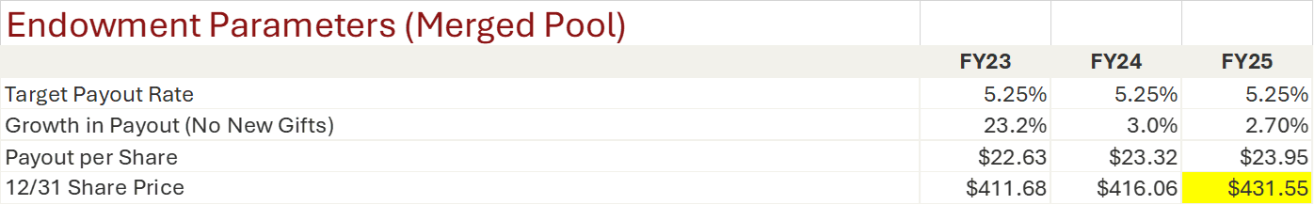
FY25 Planning Assumptions (Updated)

Slide 9
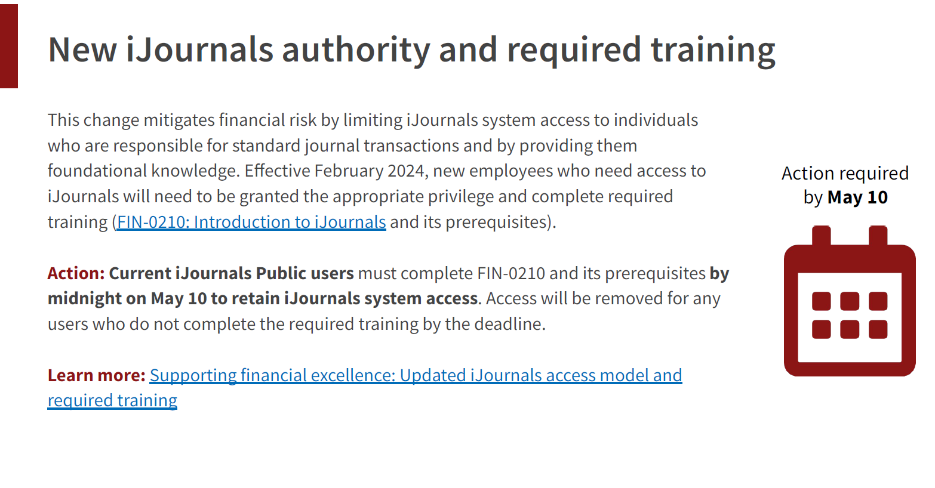

Slide 10
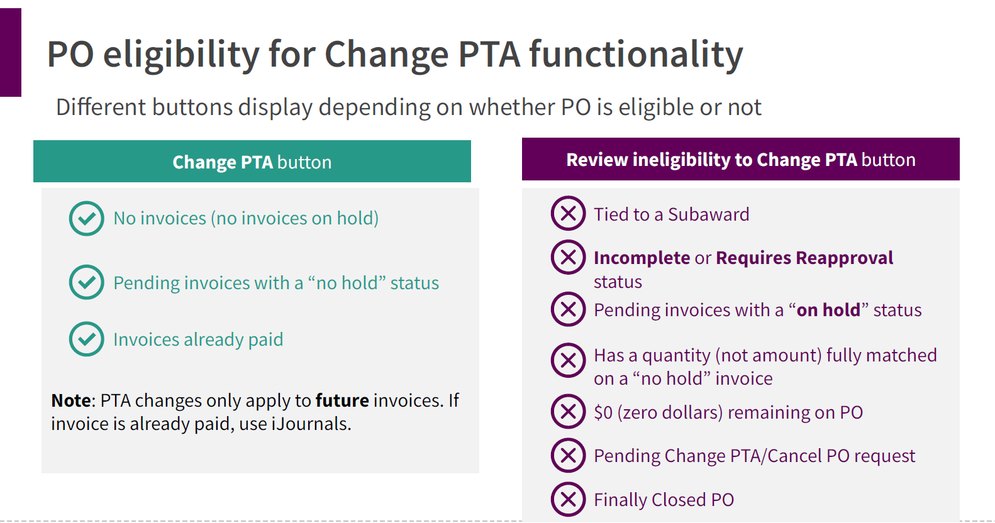

Slide 11
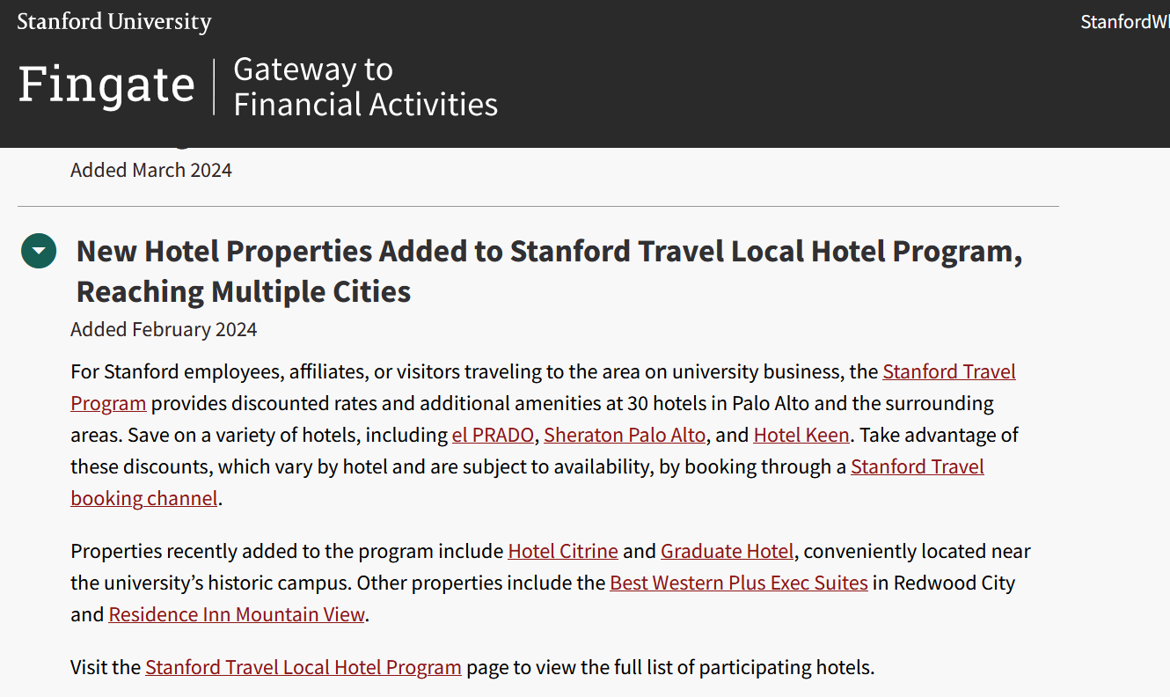
Stanford Travel Local Hotel Program Link

Slide 12
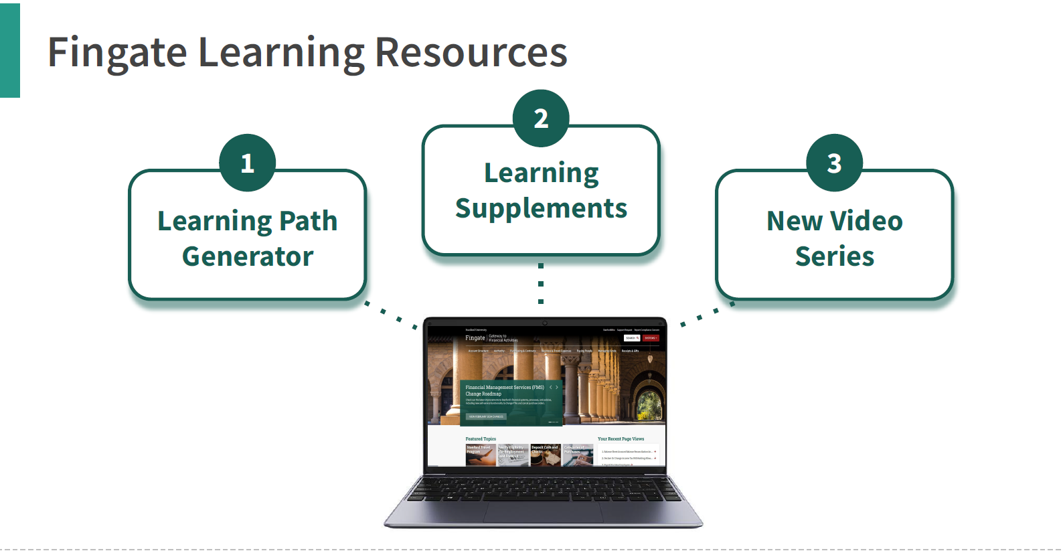

Slide 13
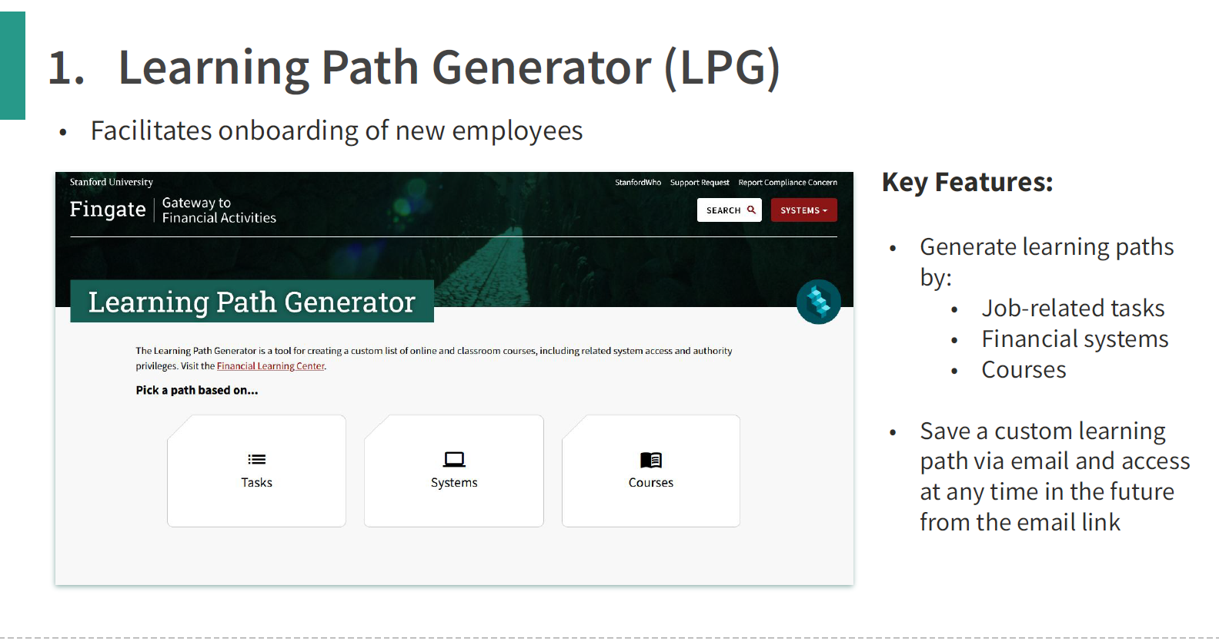
https://fingate.stanford.edu/lpg

Slide 14
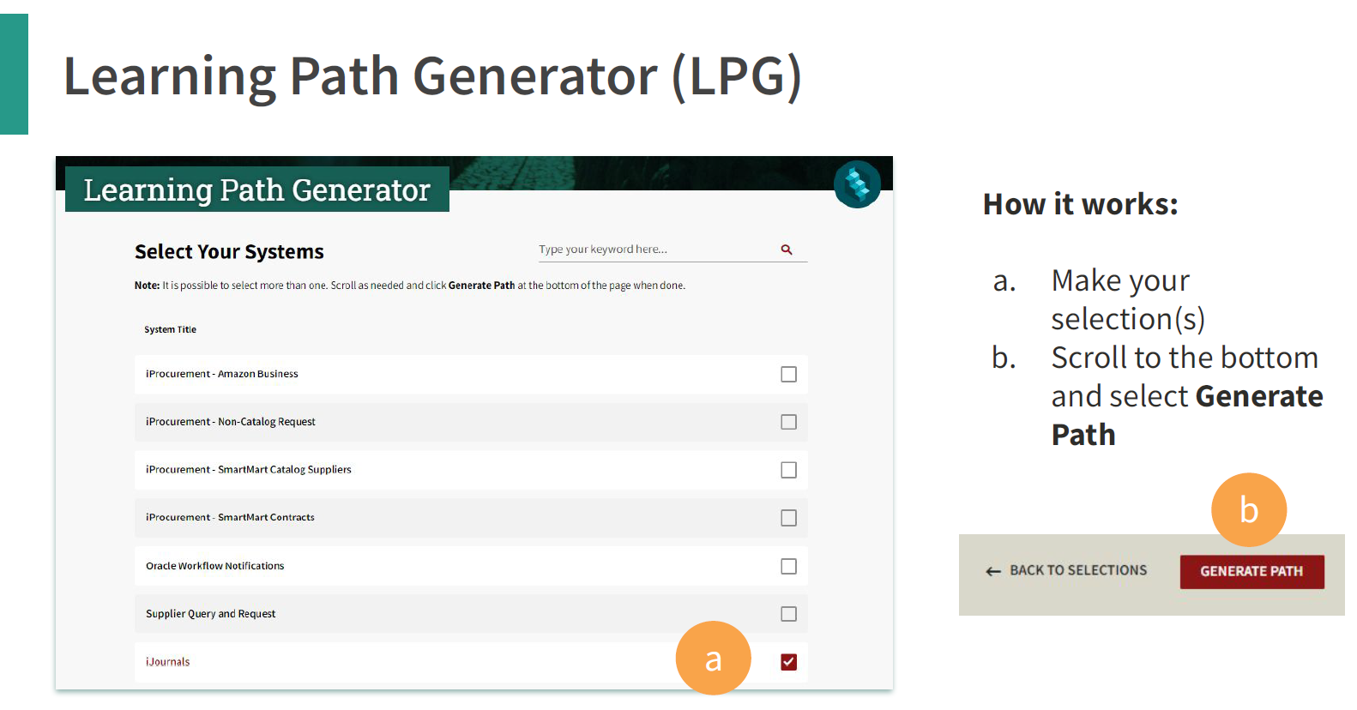

Slide 15
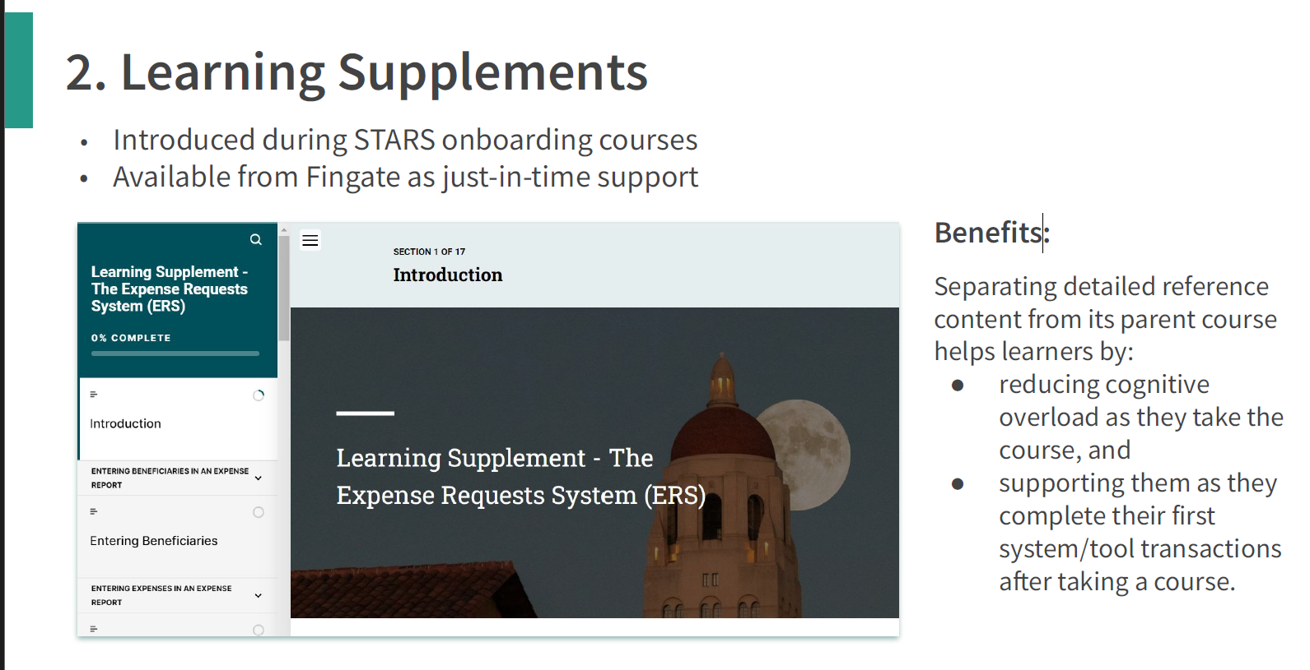

Slide 16
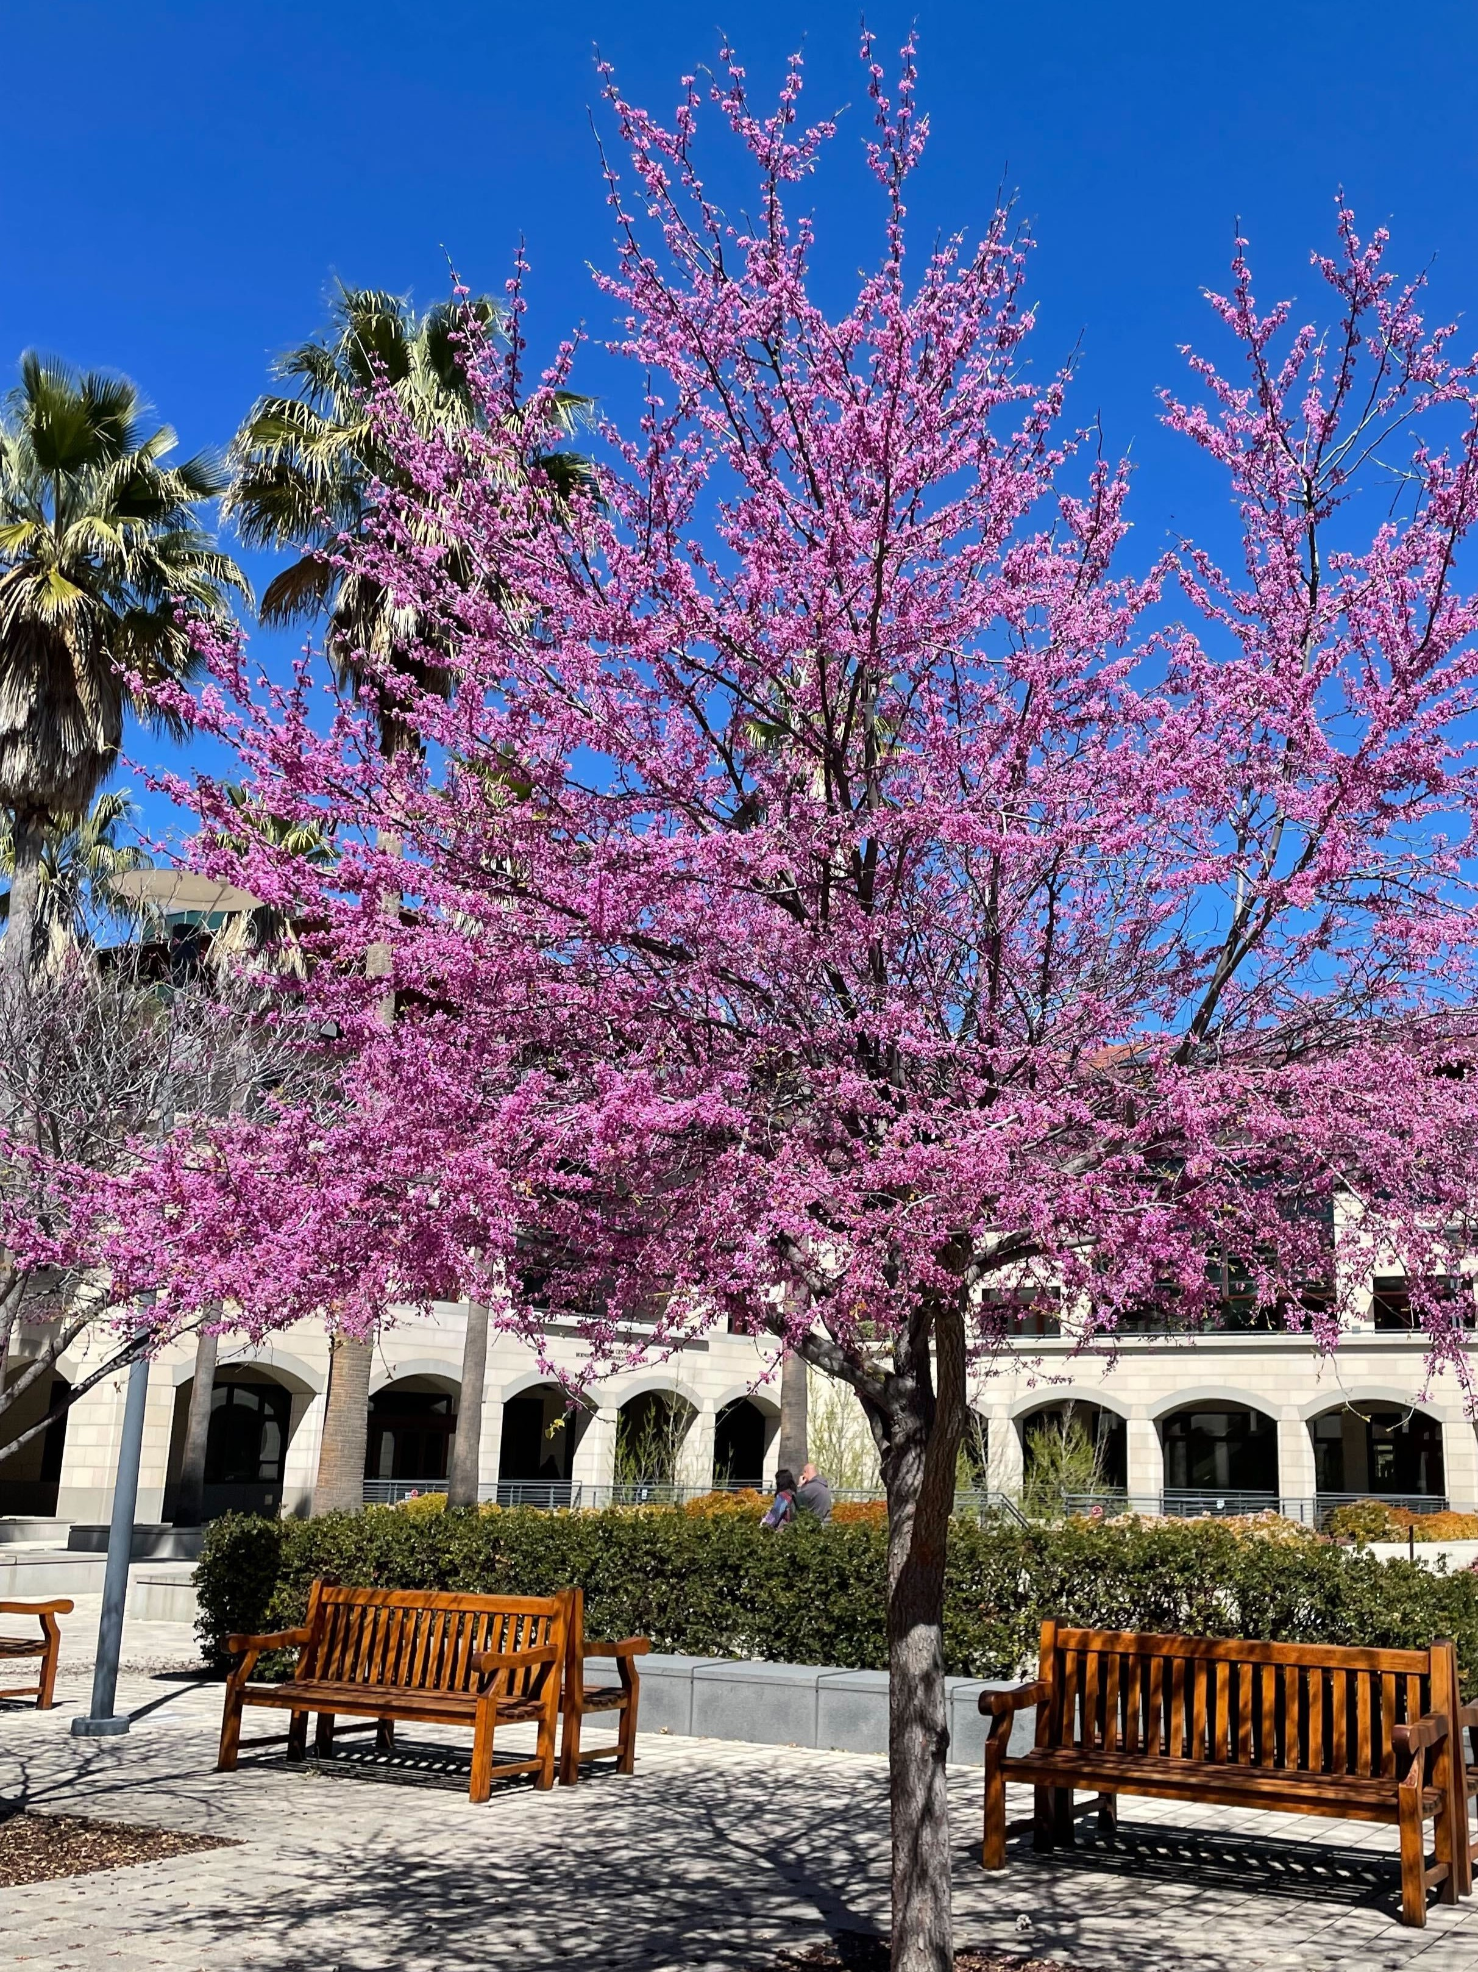
Give this a try and utilize for the onboarding process or as a reference
https://fingate.stanford.edu/lpg

