Slide 1
VPDoR Finance Update
October 2023

Slide 2
Topics
Gift policy update
Pcard/Tcard suspension process update

Slide 3
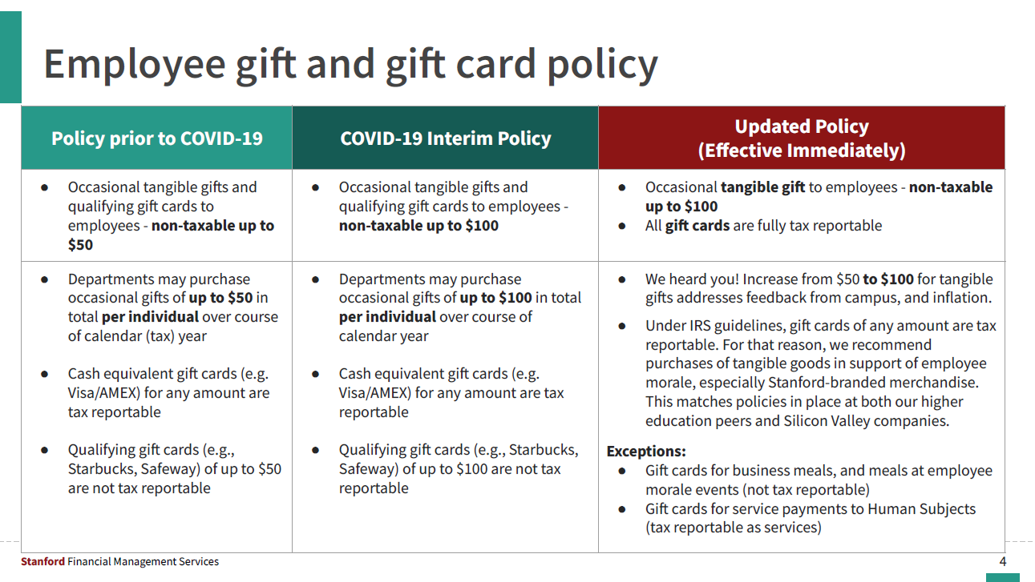

Slide 4
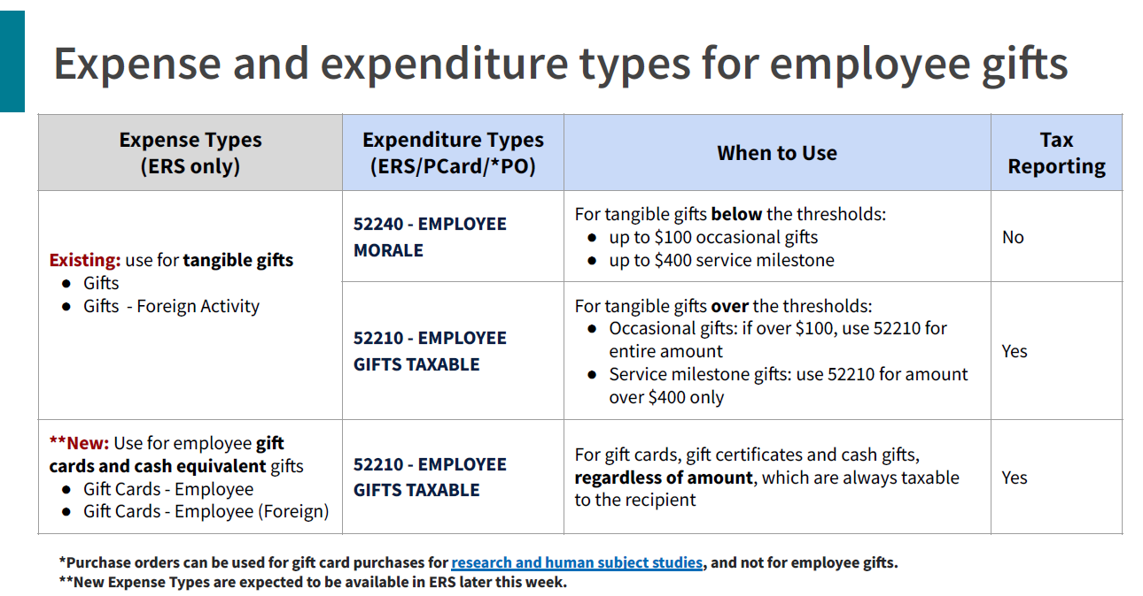

Slide 5
Taxable Gift Card Processing
Tracking and reporting:
The preparer of the transaction will need to include the recipient’s name and occasion for the gift in the transaction to allow for the value to be tax reported to the employee receiving the gift. Please refer to this Fingate news article Fingate news article for the full information, specifically “How should gifts be tracked and reported?” section.
Payroll process:
Once the reimbursement for your purchase of gift card has been processed, this taxable transaction will be reported to payroll and associated FICA (OASDI and MED) taxes will be deducted from the recipient’s upcoming paycheck. Employees will not receive any special tax documents that include the gift card amount.

Slide 6
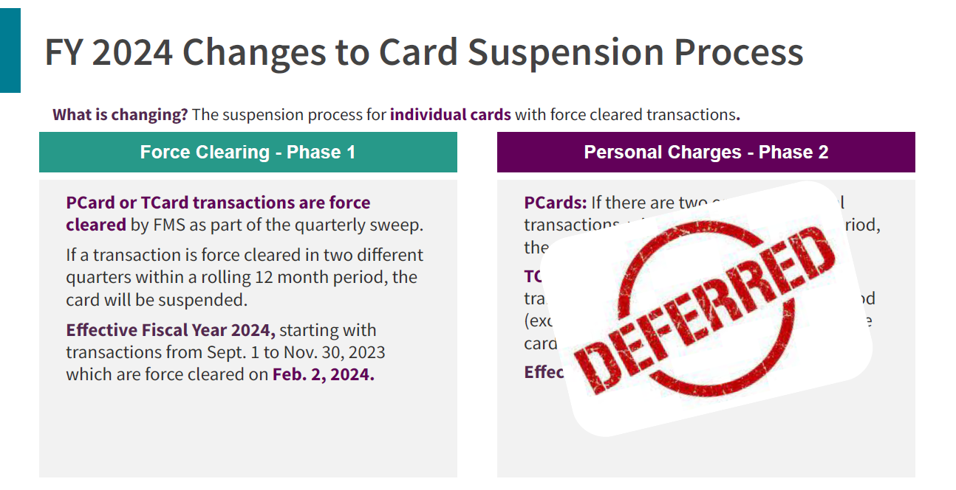
Notes:
Aging Transactions (60 days and over)

Slide 7
