Slide 1
The NIH Data Management and Sharing Policy:
Updates and Services
John Borghi, PhD
Manager, Research and Instruction
Lane Medical Library
Scott Edmiston, JD, CIPP/US
Research Data Governance and Privacy Director
Vice Provost and Dean of Research

Slide 2
Slides: https://bit.ly/nih-dms-nov22
Contact John: jborghi@stanford.edu
Contact Scott: scotted@stanford.edu

Slide 3
Links and Resources
Online Resources
NIH’s Data Sharing Page
FORMS-H: Instructions, Forms, and a Handy Checklist
Responding to the NIH Data Management & Sharing Policy (Library Guide)
NIH Data Management and Sharing FAQs (VPDOR)
SPORR Colloquium and Help-a-thon (January 23rd)
Stanford DMP Service
Workshops and Discussion
Bay Area Open Science Group – New Federal Open Science Policies (11/29)
Understanding NIH Data Management and Sharing Requirements (12/6)

Slide 4
Today’s Agenda
The NIH DMS Policy
Policy Basics
Data Management and Sharing Services
Preparing for the Policy
Q&A

Slide 5
The 10,000 foot view
Proposals received by NIH after January 25th, 2023 will require:
Submission of a Data Management and Sharing Plan (DMSP) outlining how scientific data and any accompanying metadata will be managed and shared while taking into account any potential restrictions or limitations.
Compliance with the awardee’s plan as approved by the NIH ICO. The contents of the DMSP will be incorporated into the Terms and Conditions of the award. Compliance will be monitored as part of the RPPR process.
Read the full NIH DMS Policy
Elements of an NIH Data Management and Sharing Plan
Allowable Costs for Data Management and Sharing
Selecting a Repository for Data Resulting from NIH-Supported Research
Protecting Privacy When Sharing Human Research Participant Data
Implementation Details

Slide 6
Defining our Terms
Data Management - The process of validating, organizing, protecting, maintaining, and processing scientific data to ensure the accessibility, reliability, and quality of the scientific data for its users.
Data Sharing - The act of making scientific data available for use by others (e.g., the larger research community, institutions, the broader public), for example, via an established repository.
The DMS Policy is NOT a blanket “open data” policy, but researchers will be asked to be specific about what restrictions on sharing pertain to their data and why.

Slide 7
Data Management
An essential first step in effective data management is planning.
Under the DMS Policy, NIH requires researchers to prospectively plan how they will manage and share their data. Then communicate their intended practices and strategies through the the completion of a data management and sharing plan (DMSP).
  DMSPs are short (2 pages or less) documents that outlines how data will be managed, preserved, and made available to others.
  DMSPs will be evaluated by NIH program staff to ensure that all required elements have been addressed. Peer reviewers will generally not see the DMSP and it will generally not be factored into the impact score.
  Make sure to carefully read the funding opportunity announcements for more information about what should be included in the DMSP and how they will be evaluated.

Slide 8
Writing a DMSP
There are six required elements that must be covered in a DMSP
  Data types
  Related software and code
  Standards
  Data preservation
  Use limitations
  Roles and responsibilities
NIH has provided a formatting guide for DMSPs, but researchers are not required to follow it.
DMPTool can also be used to format effective plans
Elements of an NIH Data Management and Sharing Plan

Slide 9
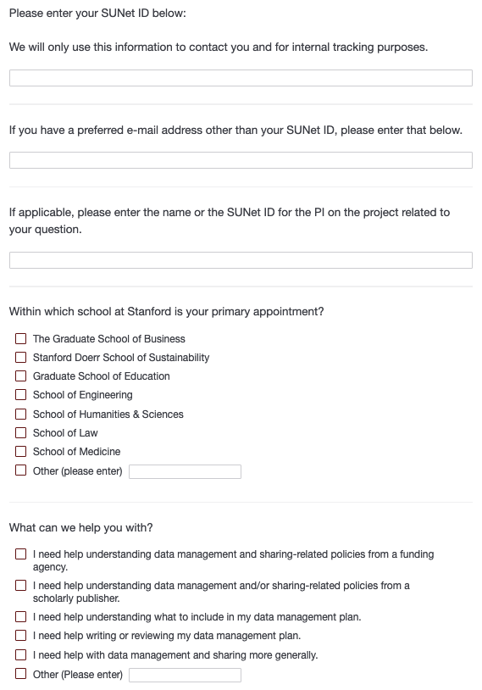
Stanford DMP Service
Co-run by Lane Library and Stanford Libraries, the Stanford DMP Service is designed to provide a point of entry for researchers who want assistance with:
  Understanding data-related policies
  Writing effective data management and sharing plans
  Implementing data management and sharing-related practices and strategies
This service is free of charge and open to all Stanford-affiliated researchers.
DMP Service Intake Form

Slide 10
Stanford DMP Service
Members of the DMP service will:
Provide their expertise in data management-related practices and strategies to help Stanford researchers create and implement data management plans that meet or exceed the expectations outlined by their funders.
Refer clients to other campus services and offices for questions specific to those areas.
Stay current on data-related requirements and changes to policies for major federal funding agencies.
Provide self-service guidance.
Share sample DMSPs (with permission, of course)
DMP Service Intake Form

Slide 11
Stanford DMP Service
Members of the DMP service will NOT:
Write data management and sharing plans on behalf of research teams of which they are not an active part.
Provide technical support for setting up data management systems specified in data management plans, except as part of the technical support we already provide for library-related services.
Create metadata.
We request that you reach out to us in as early as possible so that we can provide you with the help you need well before your grant is due.
DMP Service Intake Form

Slide 12
Data Sharing
In terms of what data should be shared, the DMS policy does not give a specific answer. However, one can be inferred from how it defines “scientific data”
“Scientific Data”
  “The recorded factual material commonly accepted in the scientific community as of sufficient quality to validate and replicate research findings, regardless of whether the data are used to support scholarly publications."
  Scientific data does not include laboratory notebooks, preliminary analyses, completed case report forms, drafts of scientific papers, plans for future research, peer reviews, communications with colleagues, or physical objects, such as laboratory specimens.

Slide 13
Data Sharing
NIH expects that in drafting their plans, “researchers will maximize the appropriate sharing of scientific data, acknowledging certain factors (i.e., legal, ethical, or technical) that may affect the extent to which scientific data are preserved and shared”.
For some programs and data types, NIH ICOs may have specific data sharing expectations (e.g., scientific data to share, relevant standards, the use of specific repositories, timelines) that apply and should be reflected in a DMSP.
  NIH encourages data management and sharing practices to be consistent with the FAIR (Findable, Accessible, Interoperable, and Reusable) data principles and reflective of practices within specific research communities.
  The current list of data sharing policies at NIH is available from Sharing.NIH.gov.

Slide 14
Sharing Human Subjects Data
In developing a Data Management and Sharing Plan for NIH-funded or supported research, it is paramount that researchers uphold the following principles.
Proactive assessment of protections
Clear communication of data sharing and use in consent forms
Consideration of justifiable limitations to sharing data
Institutional review of the conditions for data sharing
Protections for all data used in research
Remaining vigilant regarding data misuse
Allowable Costs for Data Management and Sharing

Slide 15
Sharing Human Subjects Data
NIH acknowledges there are multiple, effective strategies for achieving privacy protection in the context of the DMS Policy. The following represent best practices.
Apply appropriate de-identification.
Establish scientific data sharing and use agreements
Understand and communicate legal protections against disclosure and misuse
Protecting Privacy When Sharing Human Research Participant Data

Slide 16
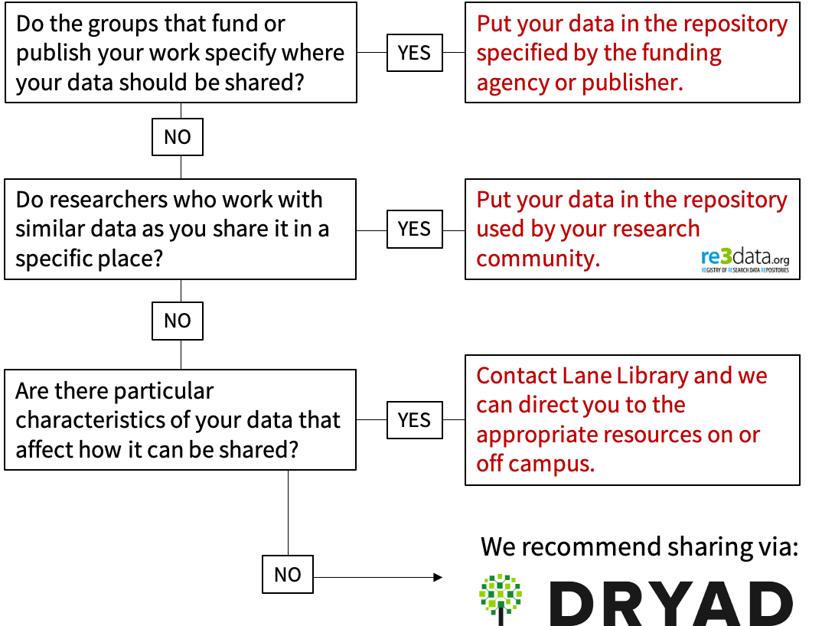
Data Repositories
Whenever possible, NIH strongly encourages that data be shared through an established data repositories.
  Discipline or data-type specific repositories are preferred when available.
  NIH is supporting generalist repositories through the Generalist Repository Ecosystem Initiative (GREI)
To find the right repository for your data, check Re3Data or NIH’s criteria for data repositories and follow the flowchart to the right.

Slide 17
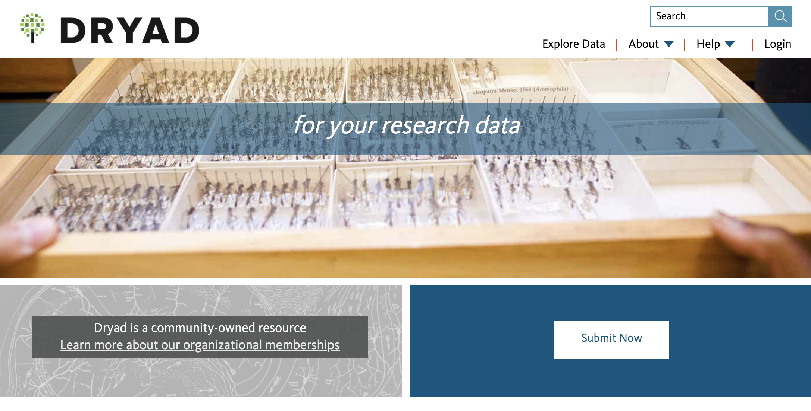
The Dryad Data Repository
Through Lane Library, Stanford is a member of the Dryad Community. This means Stanford researchers can deposit their data free of charge.
Dryad is a member of the NIH Generalist Repository Ecosystem Initiative, which seeks to improve discoverability and usability for NIH funded datasets.
Data is curated by experts to increase discoverability and ensure uploads do not contain sensitive information.
Though Dryad has many excellent features it is not suitable for restricted data.
Log in with your ORCID iD - https://datadryad.org/
For a first time login, select “Stanford” and enter your SUNet.

Slide 18
Preparing for the DMS Policy
Five Steps to Take as You Write Your Next NIH Proposal

Slide 19
1. Describe your data
The first step in understanding how to manage and share the data related to a particular project is to describe its characteristics.
Be as thorough as possible in describing the size of the data you’ll be working with, its format (or formats), its contents, and what additional materials (documentation, code, etc) are necessary to make use of it.
Probably many of these details will not make it into your DMSP, but they’ll help you decide how everything should be organized, stored, and described.

Slide 20
2. Determine what you can do
Whenever possible, the DMS policy recommends sharing data through an established data repository.
However, if your data has particular characteristics (e.g. it is particularly large, contains sensitive information that can’t be deidentified without compromising utility, or is subject to IP-related concerns), how and what you share may look very different.
Understanding if and how you will ultimately make data available at the latter stages of a project will help you choose the specific strategies, practices, and procedures you will need to implement at earlier stages.

Slide 21
3. Reach out to local expertise
Understanding the constellation of issues, practices, and technologies related to data management and sharing is not always easy.
Reach out to the Stanford DMP Service.
Schedule a consultation or join a free workshop with Lane Library.
Come to the help-a-thon at the SPORR Colloquium in January.
This is not at all an exhaustive list. Please reach out!

Slide 22
4. Write your DMSP
Once you have described your data, thought about how you might make it available, and connected with local resources, completing your data management and sharing plan should be more straightforward.
Refer to related guidance and use the DMPTool, which is free and accessible using your Stanford credentials, to make this process as easy as possible.
Lane Library also maintains a DMSP checklist for your reference.
Please get in touch with the Stanford DMP Service as early as possible.

Slide 23
5. Data management as a research practice
Creating a data management plan for a grant proposal is really just the beginning.
Once funded, you will be held to the contents of your plan. This requires implementing strategies and practices throughout your entire research workflow.
For more information, see Lane’s Data Management and Sharing Guide and our Data Management Checklist.

Slide 24
Human Participant Protections – Policy does not alter the basic Privacy and ICF regulatory landscape
Is the DMS Policy a guide for privacy and ICF compliance ? NO
Are there new informed consent or privacy legal requirements? NO
Are there new principles, best practices, and points to consider? YES
Does the DMS Policy modify or complement the OSP Informed Consent Guidance for Secondary Research with Data and Biospecimens? Complement
Does the DMS Policy modify or complement the GDSP, HIPAA, CoC’s, FDA regs, the Common Rule, or State Law? Complement

Slide 25
Protection of Research Participants
Encourages (but does not require) researchers and award recipients to:
Address data management and sharing plans during the informed consent process to ensure prospective participants understand how their data will be managed and shared;
Outline steps they will take for protecting the privacy, rights, and confidentiality of prospective participants (i.e., through de-identification, CoC’s, and other protective measures);
Assess limitations on subsequent use of data and communicate these limitations to the individuals or entities (e.g., repositories) preserving and sharing the data; and
Consider whether access to shared scientific data derived from humans should be controlled, even if de-identified

Slide 26
Protection of Research Participants – ICF and broad future use
Does the Policy require that informed consent obtained from research participants allow for broad sharing and the future use of data (with or without identifiable private information)? NO
Does NIH strongly encourage researchers’ intention for scientific data management and sharing to be part of the informed consent process? YES
For example, a study may plan to utilize consent for broad sharing of identifiable private information (e.g., the broad consent provision of the Common Rule at 45.CFR.46.116(d))) but it is not required by the DMP Policy.

Slide 27
NIH Privacy Supplement
Supplemental Information to the NIH Policy for Data Management and Sharing: Protecting Privacy when Sharing Human Research Participant Data (NOT-OD-22-0213)
6 Principles for Protecting Privacy When Sharing Data:
1. Proactive assessment of protections.
2. Clear communication of data sharing and use in consent forms.
3. Consideration of justifiable limitations to sharing data.
4. Institutional review of the conditions for data sharing.
5. Protections for all data used in research.
6. Remaining vigilant regarding data misuse.

Slide 28
NIH Privacy Supplement
Supplemental Information to the NIH Policy for Data Management and Sharing: Protecting Privacy when Sharing Human Research Participant Data (NOT-OD-22-0213)
Best Practices for Protecting Privacy When Sharing Data:
Apply appropriate de-identification
Establish Scientific Data Sharing and Use Agreements (preferably standardized), key elements including
  Oversight
  Responsibilities
  Restrictions
Understand and Communicate Legal Restrictions Against Disclosure and Misuse
Points to consider for ‘controlled access’ (CA) v. whether to share data openly ‘without access controls’
  Explicit sharing limitations → controlled access
  Presence of sensitive data → controlled access
  Can not be de-identified to definable standard → controlled access
  Participants explicitly consent to sharing without restrictions → share data without access controls
  Data de-identified and institutional review determines very low risk → share data without access controls

Slide 29
Slides: https://bit.ly/nih-dms-nov22
Contact John: jborghi@stanford.edu
Contact Scott: scotted@stanford.edu

