Slide 1
VPDoR Finance Update
June 2023

Slide 2
Topics
Airfare booking update
New single/sole Source justification (SSJ) Form
Endowment funds with award purpose FAC_FELLOW, FAC_CHAIR - ISC waived
Microsoft license cost for FY24

Slide 3
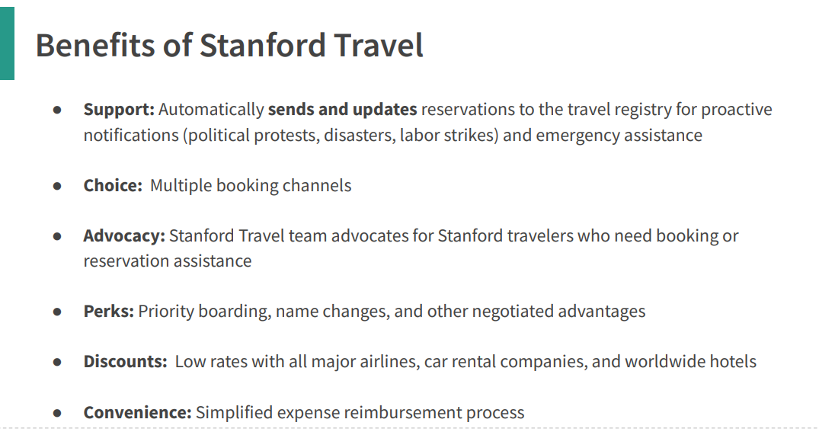
Airfare booking update

Slide 4
*
* Not recommended

Slide 5
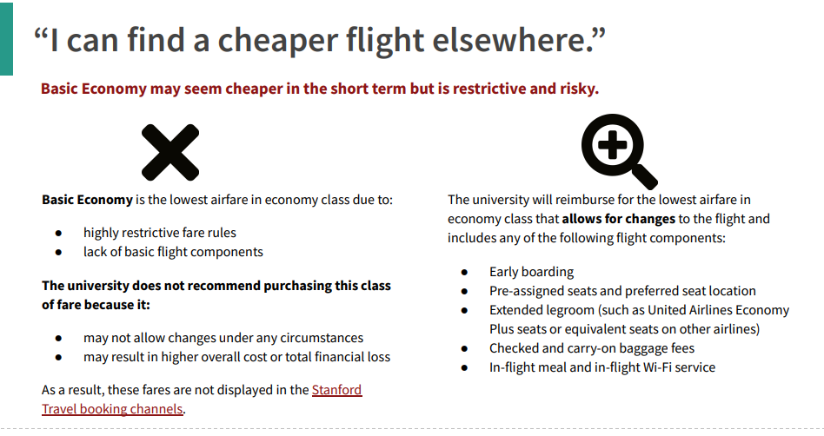

Slide 6
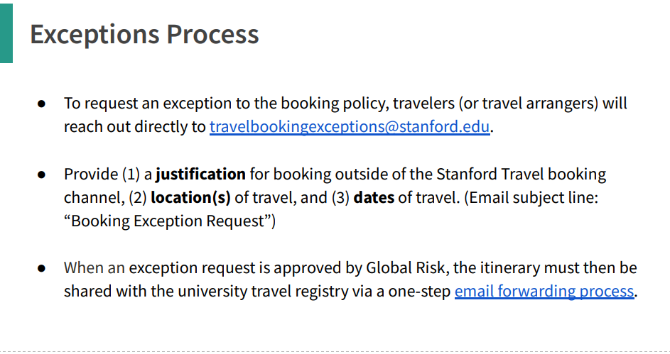
NEW

Slide 7
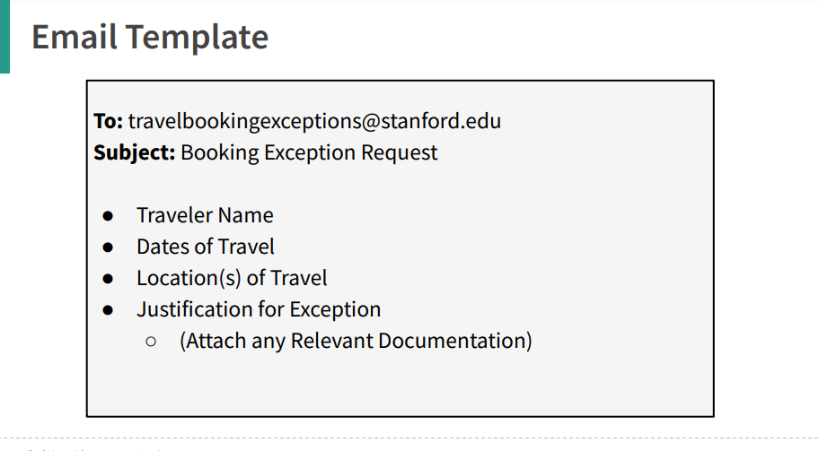

Slide 8
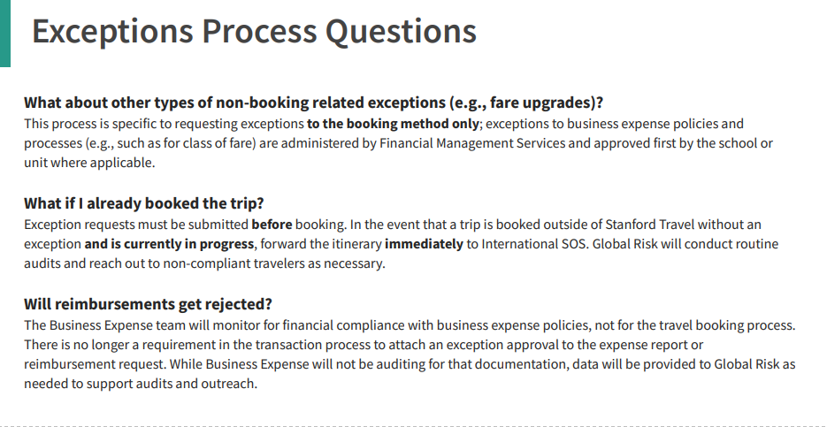
VPDoR recommends attaching the exception approval

Slide 9
New Single/Sole Source Justification (SSJ) Form
What is changing and why
The Single/Sole Source Justification (SSJ) form was updated to provide greater ability to support compliance with the university’s competitive supplier selection process as well as increase efficiency and ease of use. The updates to the form include:
• Consolidating the form from three pages down to one
• Adding dynamic fields which display or hide additional questions based on the users’ answers
• Reducing the requested backup documentation so that it is very specific and based on user selections
To learn more about when the Single/Sole Justification (SSJ) form is used and more details on why the form changed, refer to the Updated Single/Sole Source Justification (SSJ) Form news page on Fingate.

Slide 10
Endowment Funds with award purpose FAC_FELLOW, FAC_CHAIR - ISC waived
Per administrative guide 3.3.1, Endowment funds whose purpose is restricted by the donor to academic-year tenure line salaries (professorships), undergraduate and graduate student financial aid, or undergraduate research opportunities are not subject to the infrastructure charge.
For endowment funds supporting academic-year tenure line salaries (FAC_FELLOW) or professorship (FAC_CHAIR), it is necessary to allocate the entire amount towards salaries in order to qualify for an ISC waiver.
To ensure the ISC waiver is accurately set in Oracle, fund accounting recommends that the gift transmittal clearly states that the funding will be exclusively utilized for tenure line salaries. By doing so, fund accounting will designate the award purpose as FAC_FELLOW and waive the ISC accordingly.

Slide 11
Microsoft License Cost for FY24
Microsoft Enterprise Agreement will be renewed in the fall of 2023.
Preliminary estimated FY24 cost for Vice Provost and Dean of Research was $73K, an estimated increase of 94%.
UIT has conducted extensive negotiations with Microsoft to lower our Campus Enterprise Agreement renewal cost. The negotiated price is $54.6K for VPDoR, 44% higher than current price.
Cost is allocated to DoR units based on headcount twice a year in June and in August.

