Slide 1
VPDoR Financial Update Jan 23 2023 - Topics
Honorarium guidelines
Quarterly financial attestation process
Microsoft Enterprise License renewal FY24
Budget Plan kickoff/training session 1:30 pm on Feb 1

Slide 2
Reminder to complete Training Course
FIN-PROG-0103: Approving Financial Transactions course is required for all existing requisition, expense journal and labor distribution approvers. Training needs to be completed before January 31, 2023 in order to maintain authority approver privileges.

Slide 3
Honorarium guidelines
Definition
An honorarium is typically a one-time gratuitous payment made as a gesture of goodwill and in appreciation to speakers or participants in special Stanford events (e.g., symposia, lecture series or professional conventions). An honorarium is provided to help cover costs for volunteers or speakers.
What is not considered honorarium:
If the fee is required by the individual or is negotiated, payment is no longer considered an honorarium, but rather a fee for service. This fee is processed as a service requisition.
If the person receiving honorarium provided service besides speaking at or moderating an event
If someone teaches a course
Not for travel expenses
Guideline for amount
Amount should be consistent with similar payments in the past.
The amount may vary by department. In general, if amount is over $5K – speaker usually has a critical profile; $10K or higher – speaker with important status (e.g. officials with important positions, Nobel prize winners, etc.) and speaker profile document should be attached to transaction. The amount should not exceed $20K for anyone.
The amount should also correlate to the amount of time involved (e.g. number of days)
Tax implication
Tax treatment for the speaker is different for honorarium
If the amount will be $5K or higher, please reach out to dean’s finance team before solidifying the arrangement.
Fingate information https://fingate.stanford.edu/paying-people/paying-honoraria#anchor-21096-content

Slide 4
Quarterly Attestation Process
The quarterly reconciliation and attestation process is a key control in the University’s overall financial process for balance sheet accounts. It is especially important at the end of each fiscal year, since our year-end numbers are subject to audit by our external auditors.
Current deliverable date for the Q1 FY2023 Attestation: 1/20/2023, Friday
Process:
VPDoR receives financial report from FMS
Dean’s office sends information and inquiry to respective units
Units provide explanation/validation or make correction
Dean’s office submission to FMS
Fingate information about the Attestation Process https://fingate.stanford.edu/managing-funds/balance-sheet-account-balance-reconciliation-attestation#anchor-3716)

Slide 5
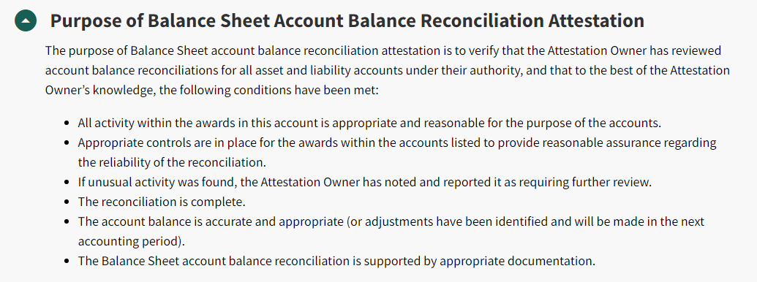
Quarterly Attestation Process – purpose and example
Example

Slide 6
Microsoft License Cost Increase FY24
Stanford is expecting an increase in cost for our Microsoft Enterprise Agreement upon renewal in the fall of 2023.
Based on preliminary discussions with Microsoft and current headcount information, the estimated FY24 cost for Vice Provost and Dean of Research is $73K, an estimated increase of 94%.
This estimate will be refined in the coming months and will be updated by April 30, 2023.
Cost is allocated to DoR units based on headcount once a year in August.

