Slide 1
VPDoR FY24 Budget Plan Process
February 1, 2023

Slide 2
Table of Contents
Introduction
Process and Timeline
Resources
Quick Guide
Q&A
Video recording: https://stanford.zoom.us/rec/share/qYfropj3sKGgM1gmqNtL-JCsD3Rpzb2-xIuSCQ7Y1MGvPd2Ycz-QnrRCfPSe4JE9.TSPiItQrJYs96FK_?startTime=1675286681000

Slide 3
Introduction

Slide 4
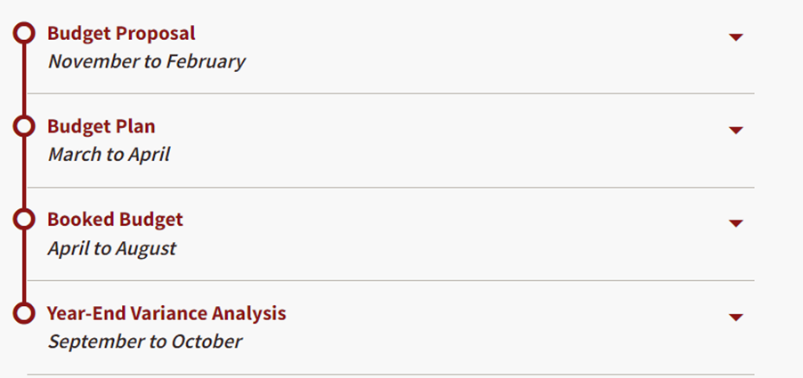
Stanford Annual Budget Cycle

Slide 5
Budget Plan Module – aligned with the university
During FY23 Budget cycle, 12 VPDoR units joined the budget plan pilot program and completed the pilot successfully
With all VPDoR units using the Budget Plan module and process, we are now fully aligned with the university
Units new to Budget Plan module – the dean’s office will provide as much support needed throughout the process

Slide 6
Some feedback from the pilot units last year:
“Training was enough as there are a lot of similarities with the June -July budget process. DoR team and the Budget office were very responsive.”
“The software entry instructions were thorough, and we were well supported.”
“Time saving from less numbers input on org code/award types level as compared to BB which is on PTA level.”
“Team support from DoR and UBO was outstanding. There were plenty of open labs to receive help.”

Slide 7
Process and Timeline

Slide 8
Budget Plan Process timeline
Mar 1: BP Module opens for unit input
Mar 10: Endowment principal updated in TM (step 1)
Mar 21: Complete YEP and Budget Plan inputs (Step 2- 9)
Mar: Attend Open labs (next slide)
Feb 1: Kick off meeting
Feb 15: Provide Dean office organization preference
Feb: Planning preparation (review TAS data)
Review sessions with Dean Office discussing:
1) Overall Assumptions AND
2) Variance Analysis (FY23 YEP vs. BB)
Unit
Jan/ Feb
Mar 1- Mar 21
March 22-28
April
Jan: Communication and Budget Plan process preview
Feb 10: Jan Actual in TM
Feb 16: Jan Endowment payout in ™ Provide TAS data to units
Feb 20: Org Preference set up
Feb 27: FY24 GF Allocation input.
Mar 10: Feb Actual in TM
Mar 15: Base GF loaded for FY23 (YEP) and FY24 (BP)
Mar 16: TAS data loaded in TM
Mar 16: Feb Endowment payout in TM
Dean Office will reach out and set up the review.
*If you are unavailable for meeting this week, we will move up the review session.
Apr 5: Budget Plan due to UBO
Apr 12: Mar Actual in TM
Apr 18: Mar Endowment payout in TM
DoR/
UBO

Slide 9
Mark Your Calendar - Budget Office Open Lab
Budget Plan Training (UBO-2000-WEB)
In Person and Zoom based Open Lab twice a week
Schedules
To be Announced

Slide 10
Training and Support
Training course in STARS (UBO-2000-WEB)
Keep this deck as reference (quick guide attached)
Reach out to your finance contact or via Slack group: vpdor-finance-units-connect
Attend open labs (work alongside your colleges and Tidemark experts)

Slide 11
Quick Guide

Slide 12
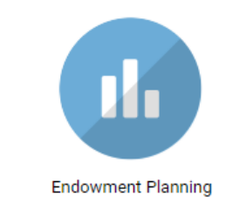
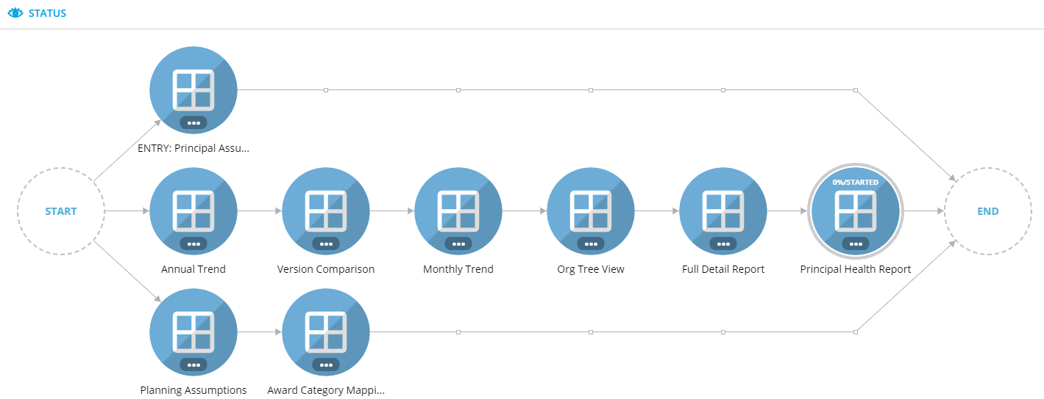
Step 1. Endowment Planning Module (due Mar 10)
2. Modify Principal (Addition / Reduction)
Various Reporting Options
1. Evaluate Annual Principal growth
Same process as booked budget
* Skip this step with no change in Endowment Principal assumptions

Slide 13
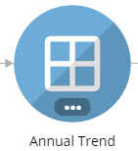
Step 1.1 Endowment Planning Module (due Mar 10)
Default to PAYOUT, with other metrics available to be included to the report

Slide 14
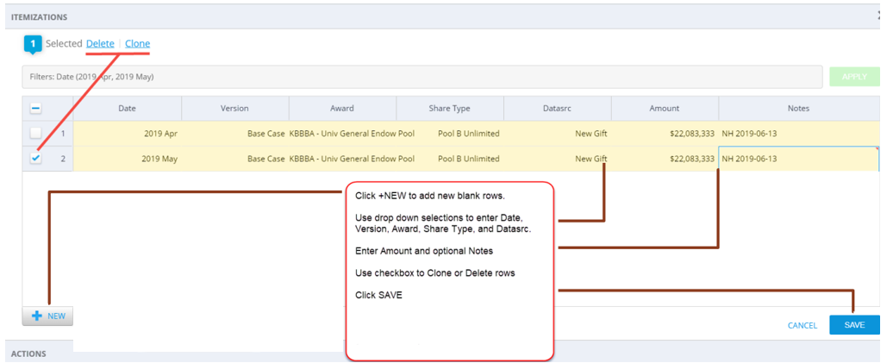
Step 1.2 Endowment Planning Module (due Mar 10)
Click “Itemization on the left menu bar to start the process
Create new entry using + NEW button on the lower left-hand corner
Incorporate all the changes anticipated.
Calculation will be done overnight, check your result at [Endowment Planning] the following day

Slide 15
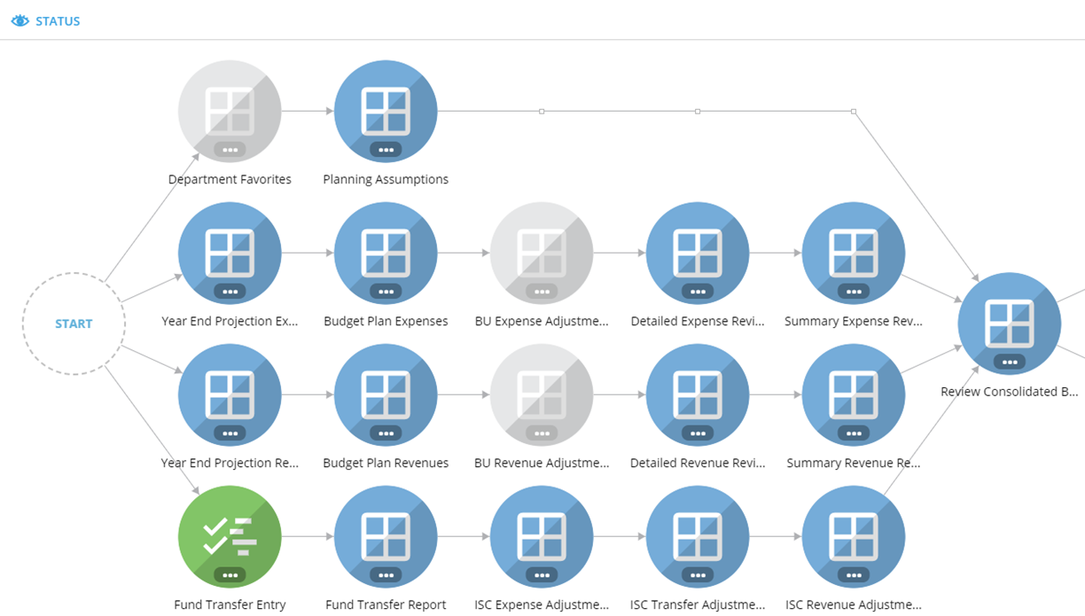
Budget Plan Module
Planning Assumptions updated by UBO

Slide 16
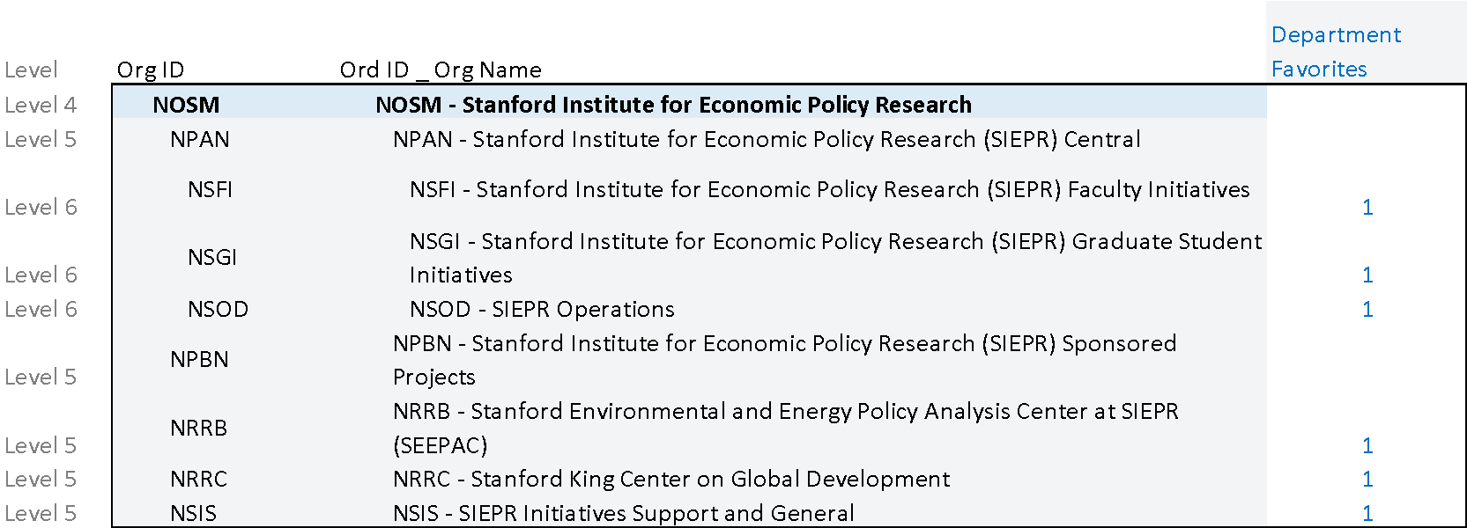
Set Department Favorite (due Feb 15)
This process is managed by the Dean office.
Select departments you wish to budget for the Year End Projection (YEP) and Budget Plan (BP) data input. This can be at the Budget Unit level, or at lower-level orgs depending on your preferred level of granularity
It can be done as a combination with unit A set for data entry at level 6 and other at level 5 (less details)
Rule: when planning on a parent level org, you cannot also plan at children of that parent and vice versa

Slide 17
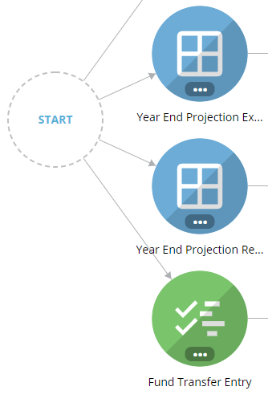
Step 2. Input FY23 YEP- Expense
Update FY23YEP with one option under Action :
YEPBBexp Seed with Booked Budget
YEPT12exp* Seed YEP with Trailing 12 months (+ Cost Rises)
*Non-Salary cost rises can be changed under Planning Assumptions panel.
Alternatively, you can choose to adjust the projection in the Year End Projection Expense Panel with a flat number or %.
Global Calc (ISC, IDC and Fringe) runs in the background every 2 hours. OR to update manually via Actions. To run Global Cal manually, click on the xx icon on the left menu bar, choose the last item on the list to process.
Global Cals: Fringe(RBE, PostDocs, Contingent, TA&RA), Grad Stipend Health Surcharge, Tuition Grant Program, Indirect Cost (IDC), Sponsored Revenue, Infrastructure Charge (ISC), (Revenue, Expense, Transfer) and Budget Plan Beginning Balance

Slide 18
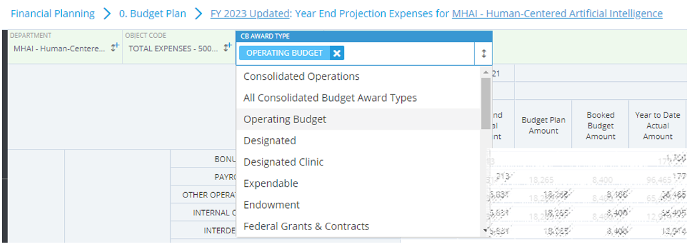
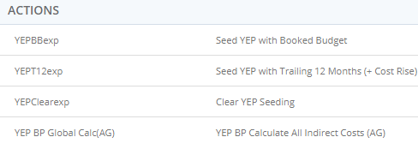
Step 2.1 Input FY23 YEP- Expense
← Data Input is required for by award type
Seed the initial projection with one of these options. Make additional adjustment if needed under [Adjustment %] or [Adjustment Amount] column.

Slide 19
Step 3. Input FY23 YEP- Revenue
Update FY23YEP with one of the options:
YEPBBrev Seed with Booked Budget
YEPT12rev Seed YEP with Trailing 12 months
You also have a choice to adjust the projection with a flat number or %. Global Calc (ISC, IDC and Fringe) will be run in the background every 2 hours,or can be updated manually. (See FY23 YEP Expense tab)
Similar to Expense entry, data input is required to be done by award type.

Slide 20
Quick Q&A

Slide 21
Step 4. Transfer Fund Entry- FY23 YEP
This panel is used to record internal transfers between award types or from transfer coming from an external source (different school)
Click + NEW to create a new entry and filled in all the fields and provide description with Scenario = “Year End Projection”
To continue with a similar entry, use the CLONE feature by checking a previously created entry. The new entry will show on the top of your screen for edit. For example, an entry was set for Year End Projection, create a similar one for Budget Plan

Slide 22
Step 4.1. Transfer Fund Type
Operating Transfers:
Funds moved between Award Type within a department to cover Operating Expenses
Interunit Fund Appropriations:
Award owned by one organization and Task on the same Award but owned by a different org
Asset Transfer:
Funds moved to/from Plant or Endowment Principal Assets
Base General Fund:
Annual General Fund allocation (where applicable)
TAS entries:
Fund support from Provost or President office
Type of Transfers to be recorded in [Fund Transfer Entry] panel
To be loaded by Dean office or UBO

Slide 23
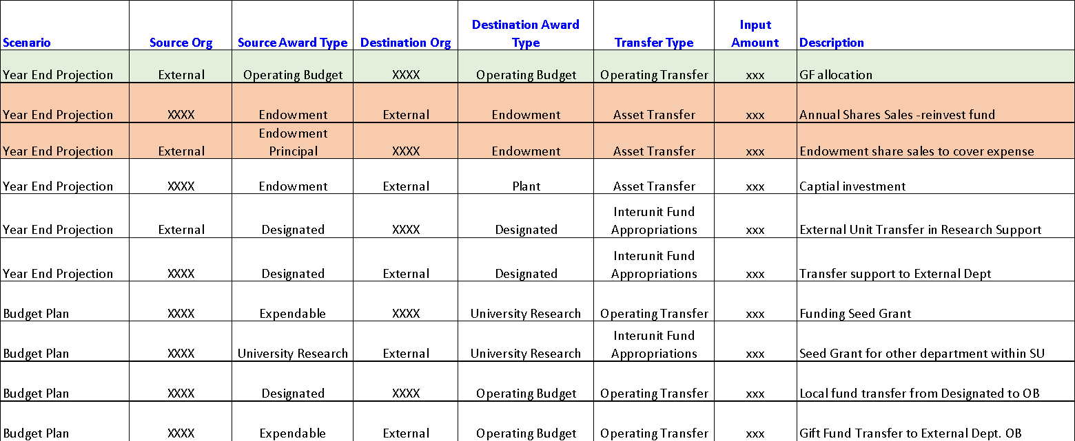
Step 4.2 Transfer Fund Entry examples
Fund Transfer process is required for both Year End Projection (YEP) and Budget Plan (BP)
External refers to an organization outside your department
Reflect the reduction of principal in [Endowment Planning] module

Slide 24
Step 4.3 Transfer Fund – Infrastructure Charges
Infrastructure Charges (ISC) incurs when Funds are transferred OUT from Expendable or Endowment
Infrastructure Charges (ISC) will be calculated by the system

Slide 25
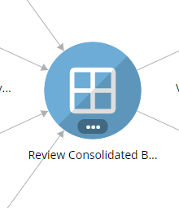
Step 5. Review Consolidated Budget
This panel defaults to TIME = FY2023 and SCENARIO = Budget Plan. Change the TIME and SCENARIO to FY2023 Year End Projection to review your update
Review expenses and revenue by award type and fine tune any of these panels as needed:
FY23 YEP Expense
FY23 YEP Revenue
Fund Transfers panel
Save your changes reflect your assumption(s)
Operating Budget fund balance is 0 and no deficits in any award types.

Slide 26
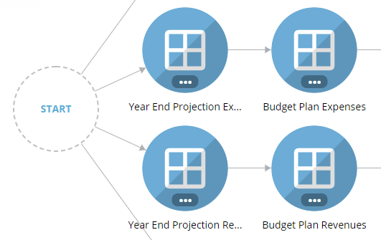
Step 6. FY24 BP- Input Expense
Update FY24 BP with one of the options:
BPYEPexp Seed BP with PY YEP + Cost Rise
BPBBexp Seed BP with PY Booked Budget + Cost Rise
Enter adjustment % or $ in the light-yellow cells to allow further adjustment after seeding to reach to the best estimate to each categories by award type.
Global Calc (ISC, IDC and Fringe) will be run in the background every 2 hours, or can be done as manual refresh under Action

Slide 27
Step 7. FY24 BP- Revenue
Update FY24 BP with one of the options:
BPYEPrev Seed BP with PY YEP
BPBBrev Seed BP with PY Booked Budget
Enter adjustment % or $ in the light-yellow cells to allow further adjustment after seeding to reach to the best estimate to all categories by award type.
Global Calc (ISC, IDC and Fringe) will be run in the background every 2 hours, or can be done as manual refresh under Action

Slide 28
Step 8. Transfer Fund Entry- FY24 BP
Refer to Step 4, slide 19-22
Choose “Budget Plan” for each entry.
Utilize [clone] feature to duplicate and modify entries.

Slide 29
Step 9. Review Consolidated Budget for FY24 Budget Plan
This panel defaults to TIME = FY2024 and SCENARIO = Budget Plan.
Review expenses and revenue by award type and fine tune any of these panels as needed:
FY24 Budget Plan Expense
FY24 Budget Plan Revenue
Fund Transfers panel
Save your changes reflect your assumption(s)
Operating Budget fund balance is ZERO and no deficits in any award types.

Slide 30
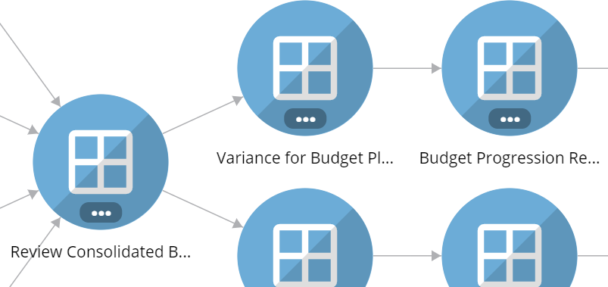
Almost there …
Review 1) Budget Progression Report and 2) Variance for Budget Plan Report
Variance for Budget Plan Report:
With variances over $100K, for either FY23 YEP or FY24 BP (under Consolidated Operations), please provide an explanation.

Slide 31
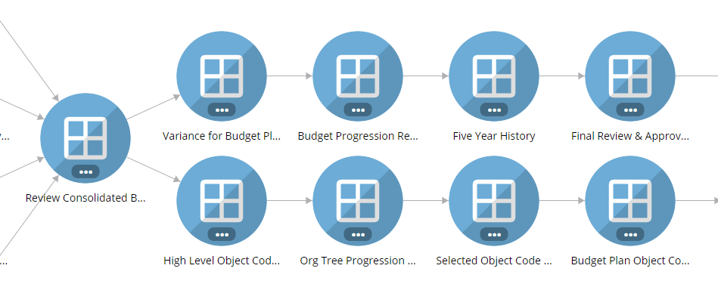
What report to use
* FY23 YEP vs BB and FY24 BP vs FY23 YEP. Use the comment section to capture major variance.
Progression of all scenario (BP, BB,YEP, YEA) in the budget cycle for the last 3 years.
Five Years comparison of any scenario for trending. Drill down capability available.
FY21-23 data at consolidated level + FY24 BP by award type
High level checking after data input. Default to FY2023 Budget Plan scenario
High level report showing Revenue, Operating Transfer, Total Expenses, etc. for both FY23 YEP and FY24 BP
Similar to “Variance for Budget Plan”, variance is shown at Org level (goes down to level 5/6/7 as applicable)
Like “High Level Object Code”, report can be filtered by object code at Org Level
Details behind each Object code by Award Type for Budget Plan Booked Budget and/or YTD Actual (if applicable).
* Input major variance in Explanation column(Consolidated view) prior to review session with the Dean Office

Slide 32
Crossing the Finish Line
After all inputs are done, review YEP and budget plan. Ensure:
Capture your Budget Plan assumptions
Revenue, expenses and transfer look reasonable
Operating budget ending balance = ZERO. No deficit on any award type
Utilize various reports to view trending
Update comments in Variance Report prior to meeting with VPDoR finance team.
Any questions or comment, please reach out to your finance liaison.

Slide 33
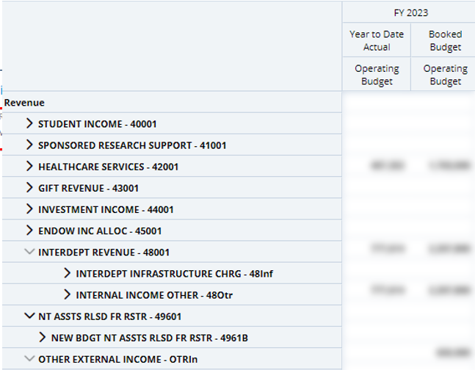
Plan your numbers
201 report. Award Type, (Operating Budget, Designated, for example);
Time = FY2023, and Scenario = Booked Budget and FY23 YTD Actual
The view can be served as a starting point of Year End Projection (YEP)
Repeat for all Award Types

Slide 34
Q&A
The key to successful execution:
Preparation ahead of March 1 &
Join open labs

