Slide 1
VPDoR FY24 Booked Budget Process Kickoff Session
June 6, 2023

Slide 2
Topics
Budget process and calendar, planning assumptions
Budgeting tips and best practices
  0. Budget approach
  1. Booked Budget- Revenue and Expense
  2. Booked Budget – Fund Management
  3. Reporting
  4. Final Review and Variance Analysis
Communication and support, references
Q&A

Slide 3
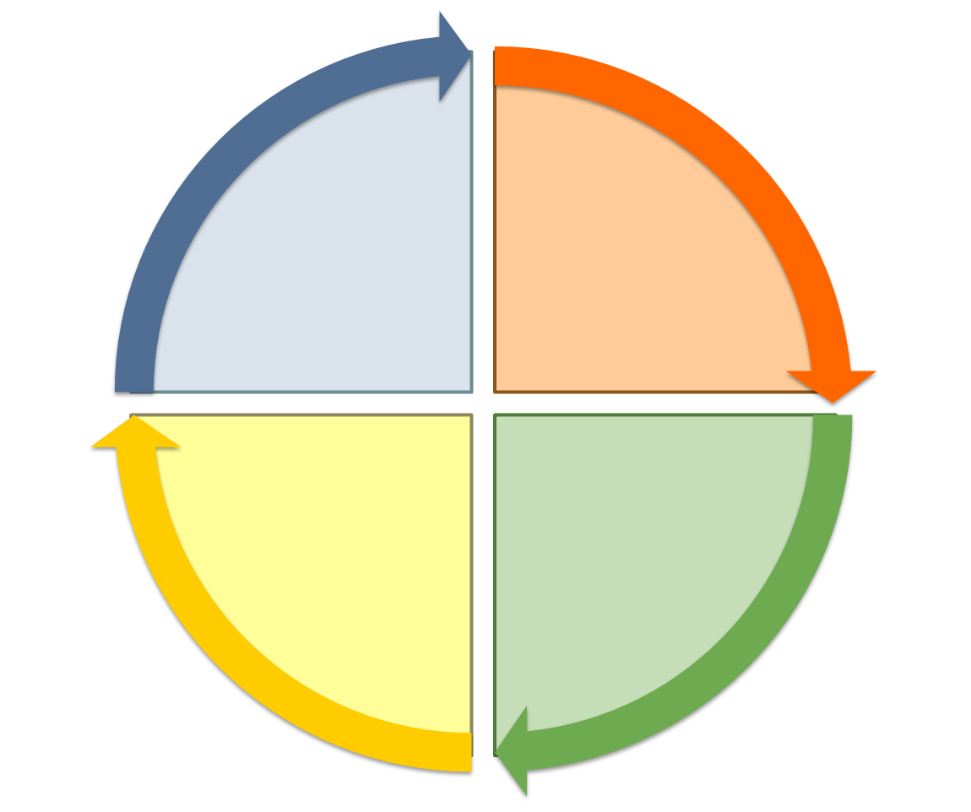
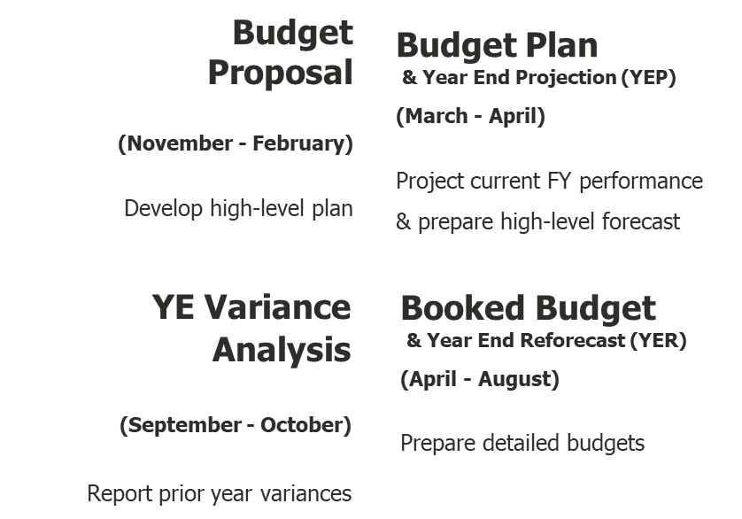
Stanford’s Annual Budget Cycle
Booked Budget
& Year End Reforecast (YER)
Major Activities:
Non-Salary Expense Planning
Compensation (Position) Planning
Revenue Planning
Endowment Planning
Fund Transfers

Slide 4









FY24 Booked Budget Process and Timeline
Get Ready
Data Input
Input and Review
FINISH LINE
5/15: Review and update Pooling Rules as needed
Attend web-based training via STARS
Review communications from the dean’s office
Early June: Attend kick off meeting (6/6)
Follow the budgeting process
Salary panels
YER +FY24 Compensation & non-Salary expenses
YER+ FY24 Revenue Assumptions
6/26: Complete Endowment principal changes
7/1: FY24 salary plan loaded in Tidemark
7/6: Complete FY23 YER
7/14: Complete Tidemark submission:
Allocate FY24 Base GF Fund
Transfer entries
Funding the budget
Review the budget using 215/221/241 reports
7/24-28: Review meeting with Dean’s office
8/3: Variance report due
Unit
May
June
July
August
1
8
15
22
29
5
12
19
26
3
10
17
24
7
14
21
Get Ready
Support
Submission
VPDoR/ UBO
Now: UBO Web-based training available
Now: UBO Open Lab schedule available
5/22: Labor schedule loaded. Based on 4/30 payroll data- one time update.
UBO: Open Lab available Tues/Wed/Thurs (see schedule)
Tidemark Training | University Budget Office (stanford.edu)
VPDoR: Finance support, DoR finance website or Slack Channel
6/6: Booked Budget Process Kick off meeting
6/30: Endowment payout updated in Booked Budget module
7/10: Base GF input
7/21: Dean office to confirm variance items required write up
8/14: Final submission due to UBO
8/21: Variance analysis due to UBO

Slide 5
FY24 Planning Assumptions
Planning assumptions are available in Tidemark Endowment Module and Booked Budget Module.
Note market/equity/retention increase is set to zero as the decisions will be made jointly with Dean’s office and amount would vary by unit.

Slide 6

True or False?
I can work on FY24 booked budget first and then come back to FY23 Yearend Forecast
I can skip around in Salary Planning panels
I don’t like funding the budget panel and I will just enter the internal funding in the external transfer panel
I don’t need to use seeding option on expense and/or revenue
PTAs in Labor Distribution panel in Tidemark is refreshed daily

Slide 7
True or False? Answer Reveal
I can work on FY24 booked budget first and then come back to FY23 Yearend Forecast
F: Although the system would not prevent you from doing so, this sequence would make your overall process difficult, and you may need to go back and forth many times. We strongly recommend you complete FY23 YER first to be more efficient.
I can skip around in Salary Planning panels
F: For salary planning by position, it is important to follow the process step by step to avoid complications. It also feeds into compensation adjustment panel.
I don’t like funding the budget panel and I will just enter the internal funding in the external transfer panel
F: This is not recommended even though the system would not prevent it. Units have experienced complications with this approach.
I don’t need to use Seeding option on Expense and/or Revenue
T: Seeding is optional and when budget is very different from historical trend, it is better to skip seeding.
PTAs in Labor Distribution panel in Tidemark is refreshed daily
F: PTA shown in Labor Distribution panel reflects 4/30 payroll. Always review the labor distribution PTA for all headcount to ensure no one is missing.

Slide 8

What Questions Would You Like Get Answered Today?

Slide 9
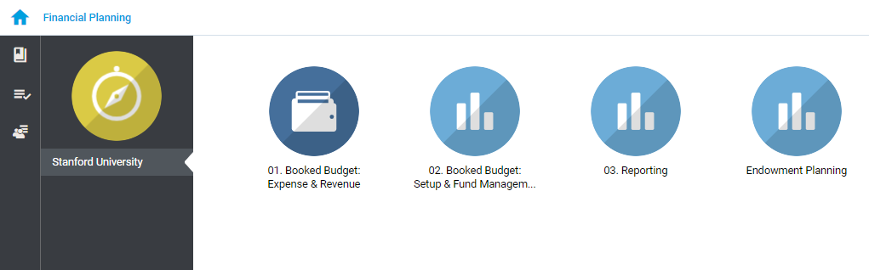
Tidemark Processes for Booked Budget
Booked Budget Processes include:
    01. Booked Budget: Expense & Revenue
    02. Booked Budget: Setup & Fund Management
    Endowment Planning
    03. Reporting

Slide 10
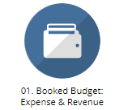
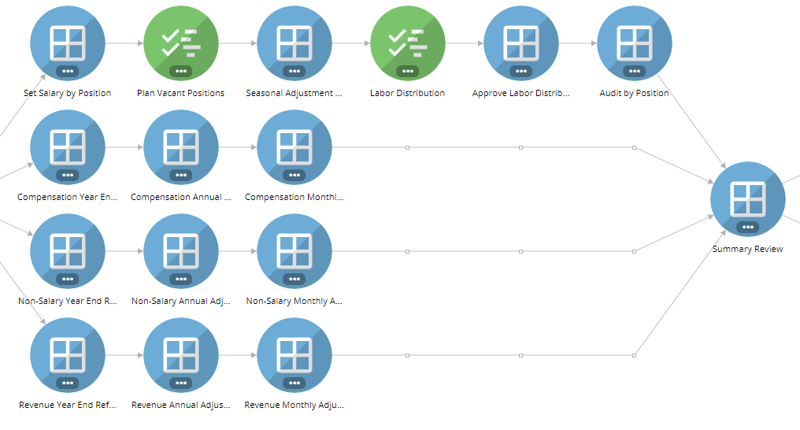
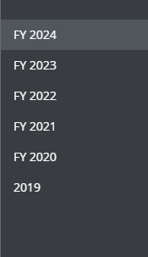
1. Booked Budget: Expense and Revenue Process
Step 1 – Salary Planning
FY 2024 Cycle
Step 4 – Review Inputs →
Pick FY 2024 for Booked Budget activities including FY 2023 Year End Reforecast
Follow these suggested steps for data input to allow data consistency
No dependency between Expense and Revenue data input activities
Step 2 – Year End Reforecast
Step 3 – FY2024
Booked Budget

Slide 11
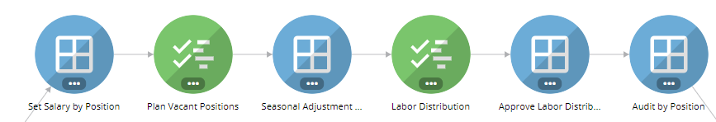
1. Booked Budget- Expense and Revenue
Step 1- Position Planning
Labor data refresh daily.
Seed Salaries using Current Salary + cost rise OR manual entries
FY24 Salary Plan will be available after unit submits via Access. Reseed Salary as needed
Add Vacant positions (including estimated pay), as needed.
OPTIONAL Adjust monthly salary
Review Labor Distribution (PTA) and make any needed adjustments.
Initial labor distribution is based on 4/30 payroll data.
Review/Approve labor distribution coming from external unit
Ensure all salary positions are correctly distributed.

Slide 12
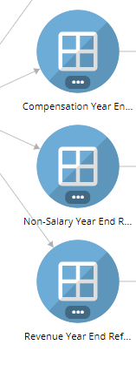


1. Booked Budget- Expense and Revenue
Step 2- Year End Reforecast
Expenses:
Compensation/Non-Salary. Seed the YER with one of the options: 1) FY2023 Booked Budget; 2) FY2023 Project Actual. 3)Trailing 12 Mos (+ Cost Rise) and add any manual entries as needed. Add manual adjustment $ or % as needed*.
Click [YER Global Calc] in Compensation panel to initiate instant calculation on Fringe expenses (system updates every 2 hours)
Revenue:
Revenue by Award type. Use the seeding options best aligned with your unit’s forecast scenario. Make manual adjustment as needed.*
*Document the justifications on manual entries will help to prep variance analysis

Slide 13
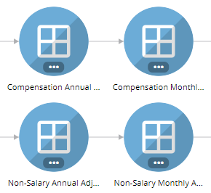
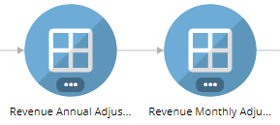
1. Booked Budget- Expense and Revenue
Step 3- FY 2024 Booked Budget
Expenses (Annual Adjustments):
Compensation/ Non-Salary.
Seed the forecast with one the options available.
Input manual adjustments for expenses such as Net Vacation*, Bonuses or casual worker.
Filter to the expenditure level for easier data input.
Click [YER Global Calc] allows instant calculation on Fringe expenses
Expenses/Revenue (Monthly Adjustments): OPTIONAL
Input from Annual panels spreads by month. Modify the monthly spread if needed.
Revenue (Annual Adjustments):
Seed the forecast with one the options available.
Add manual adjustment as needed.
** Investment Income.
*Average for Net vacation during FY17-19 could be used as a reference for FY24. Actual results during FY20-22 could be skewed by COVID impact.
** Investment Income. Could be trended based on YTD actual

Slide 14
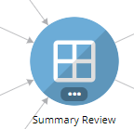
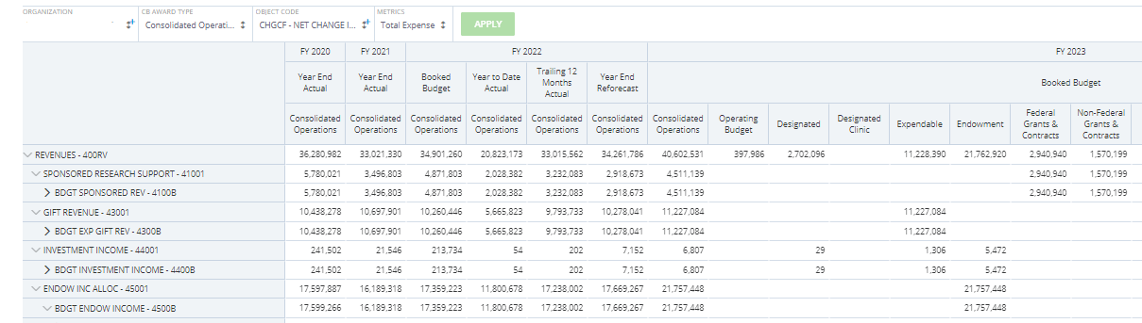
1. Booked Budget- Expense and Revenue
Step 4- Review Inputs
This panel rolls up your inputs for FY 2023 YER and FY2024 and provides trending across 4 years
The aerial view helps to determine if the revenue and expenses are reasonable and consistent
Filter to specific award type and/or object code to see a subset of data. For example: type 400RV to show revenue related items only
Special Unit

Slide 15
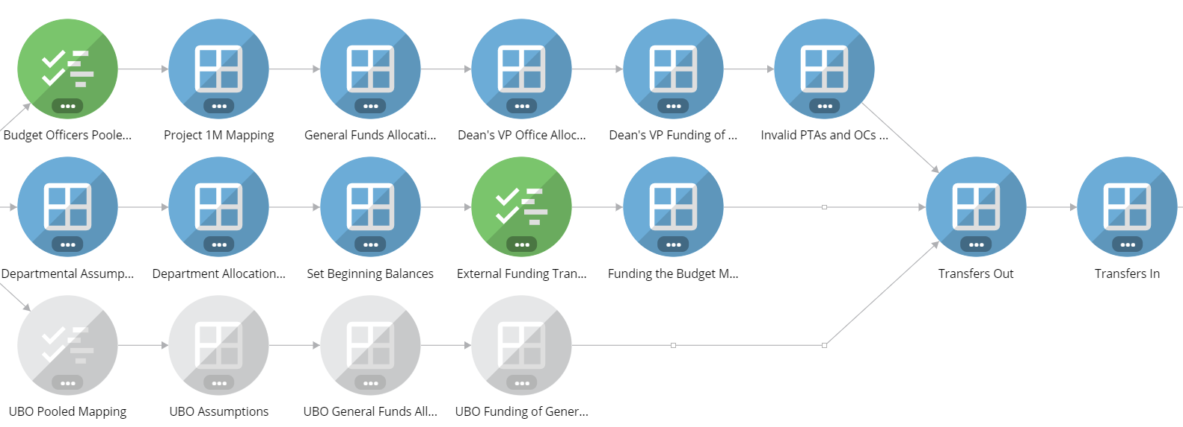


2. Booked Budget Fund Management
Follow the panels from left to right.
[Set Beginning Balance]. Ensure FY23 Ending Fund Balance = FY24 Beginning Balance
[External Funding Transfer]. Document all FY24 external fund transfers
Reports and Summary

Slide 16
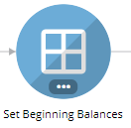
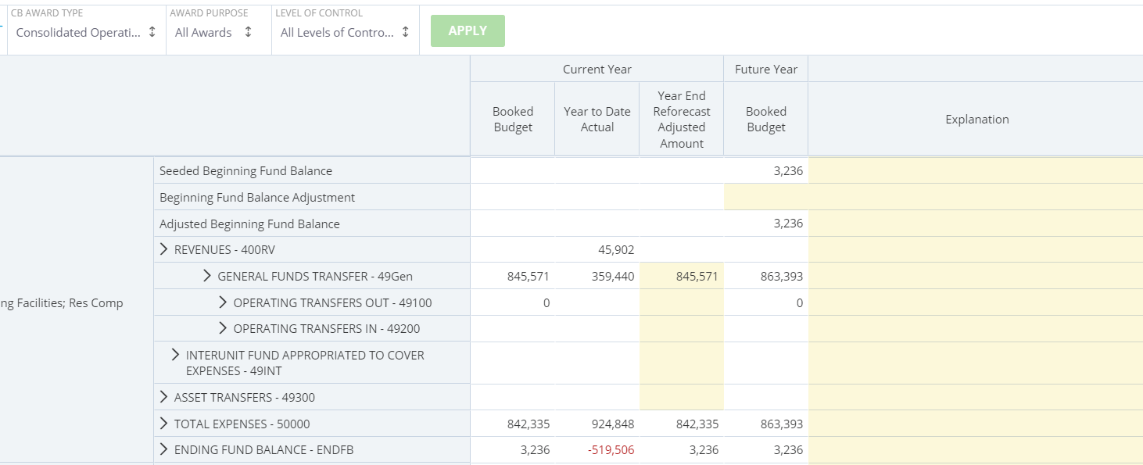
2. Booked Budget Fund Management
Step 1 Update Fund Transfers (1 of 2)
Filter down Award level/PTA to allow easier tracking
Update Fund Transfers
                General Fund Allocation
            Operating Transfer In / Out
            Interunit Fund Appropriation
            Asset Transfer
1234567-BABIE - ABC Operations Savings; Special Ops

Slide 17
2. Booked Budget Fund Management
Step 1 Update Fund Transfers (2 of 2)
Set Beginning Balance panel allows users to record fund transfers by PTA. There is no mechanism to help balance transfer in vs. out.
RECOMMENDED: With an offline Excel template, map out movement of the awards (FR and TO)
Document the funding source in [Explanation] column for record keeping
Include any ISC impacts, as applicable
Offline Excel template
OB PTA 2
*Endowment/ Expandable - Minus 8% ISC
Endowment PTA 1

Slide 18
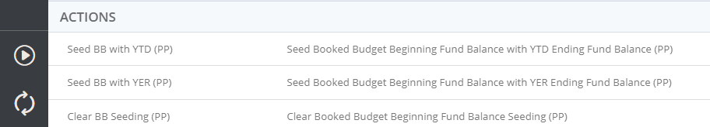
2. Booked Budget Fund Management
Step 2 – Estimate Current Year Ending Balance/ Future Year Beginning Balance
Update Fund Transfers and document the source and destination under Explanation column
1234567-BABIE - ABC Operations Savings; Special Ops
Utilize [Seed BB with YER (PP)] to bring the Ending balance of Current Year to the Beginning balance of Future Year

Slide 19
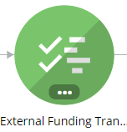

2. Booked Budget Fund Management
External Transfer- Booked Budget only*
Budget office will load TAS data on 6/1. If you do not see the entries expected, add it manually in this panel.
Operating Transfer* – Majority of transfers usually move funds between Award Types. for example, from Designated to Operating Budget, appear on the Consolidated Budget under 49OTR – Other Transfers. OB to OB between different orgs will appear on the 49NBASE – Non-Base General Funds Transfers line.
Asset Transfer – represent transfers to Asset accounts. For example, to Plant for a lab renovation or to Endowment for funds functioning as Endowment. They will show up near the bottom of the Consolidated Budget on row 49300 – Trnsfrs Other.
Intraunit Fund Appropriation – Funds from other units to cover Expenses in your unit. This will occur when the other unit owns the Award (funding) and your unit owns the Task (expenses) or vice versa. They appear in the area below Expenses on the Consolidated Budget rolling up to 49INT – Interunit Funds Appropriated to Cover Expenses.
Create a new transfer by clicking [NEW].
Add a similar transfer by clicking [NEW] or [CLONE] and modify
This can be coming from PA or external source
This can be coming from PA or external source
One of the 3 Transfer Types listed on top
$ Amount
Free Text field to document purpose of Transfer
Source or Destination contains an external member
When a funding transfer exists within the unit, record the transfer under [ Fund the budget matrix].

Slide 20
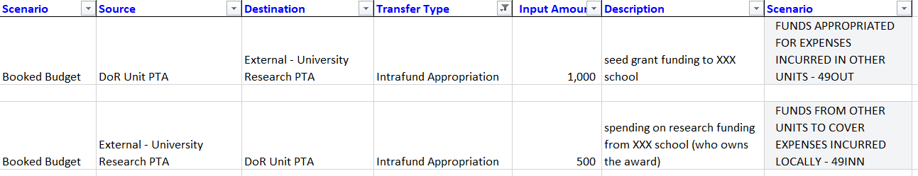
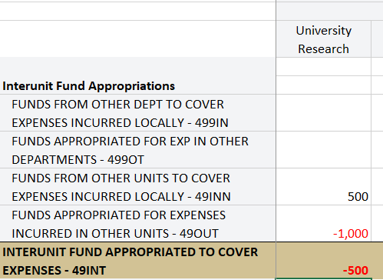
2. Booked Budget Fund Management
Intraunit Fund Appropriation
Intraunit fund Appropriation occurs when:
The other unit owns the Award (Funding) and your unit owns the Task (Expenses). OR
Funds are going out from your unit to cover expenses in the other unit. Your unit owns the Award (Funding) and the other unit owns the Task (Expenses).

Slide 21
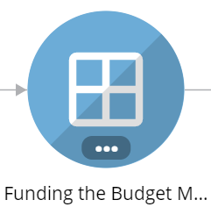
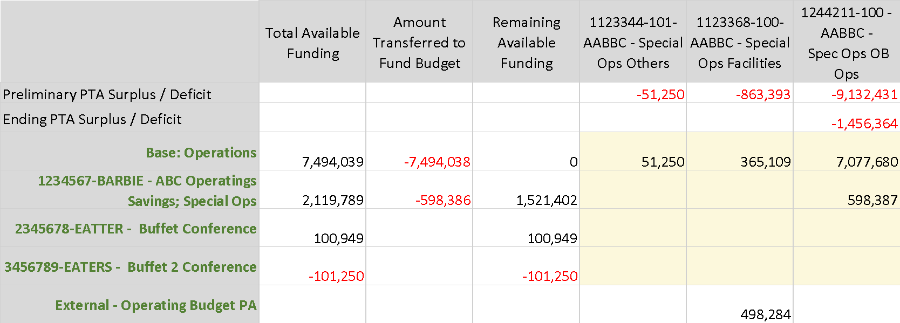
2. Booked Budget Fund Management
Funding the Budget Matrix
Allocate the Funding to support destination PTAs, start with the funds that are the most restrictive
Apply funding to ACTIVE PTAs
[Amount Transferred to Fund Budget] summarizes total amount distributed across
When allocate General Fund, need to filter the org to the general fund receiving org
Review the [Remaining Available Funding] to avoid over funding
Destination PTA
Funding Sources
*Base Funds
Funding within unit
External Funding

Slide 22
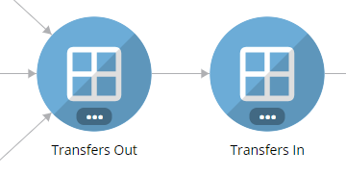
2. Booked Budget Fund Management
Report and Summary
These panels summarize the Funds movement done in External Transfer and Fund the Budget Matrix
Review to ensure accuracy

Slide 23
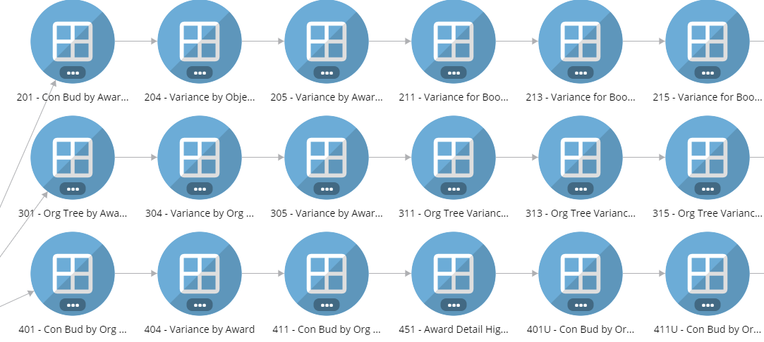
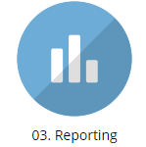
3. Reporting
Types of reports:
2 series: Consolidated with Object Code
3 series: Org Tree level Reports
4 series: Award Based Reports
5 series: Detailed level; PTA; Object Code
6 series: Compensation related
8 series: Less commonly used report
Reports Frequently Used For Booked Budget Process:
221: Progression for Booked Budget (to review the P&L for multi-years)
215: Variance for Booked Budget (for variance analysis)
241: Final Review for Booked Budget
315: Org Tree Variance. Booked Budget vs. Budget Plan (variance analysis drill down to PTA level)
* Report definitions from University Budget Office website: Tidemark-report-finder (link)

Slide 24

4. Final Review Checklist
Download checklist on DoR Finance website (link)
The checklist can help you ensure the budget is all complete and help catch errors
Please use this checklist to review the budget and send the completed checklist to dean’s office liaison

Slide 25
4.Variance Analysis - FY 24 Booked Budget vs. Budget Plan
Tidemark Reports:
Step 1: 215 report – Dean office will provide the list of items required for variance explanation
Step 2: 315 report – enter ‘Object code’ of interest to drill down by org
Dean’s Office reviews and identified object codes that required variance explanation, at the consolidated level
Your finance liaison will schedule a “Show and Tell” on how to effectively provide variance explanation.

Slide 26
4.Variance Analysis - Guidelines for Variance Narrative
Before you start writing variance explanation, ask yourself –
WHAT WAS THE ASSUMPTION USED for Budget Plan Cycle?
After identifying the key variances,
Explain WHAT and WHY and convey meaningful stories with the programmatic driver
Describe in the business context so the Dean’s office and University Budget Office can learn what’s happening with your unit. Please avoid using acronyms. Bullet points are fine.
Inadequate:
Salaries are higher due to new hire
Professional Services are low due to timing
Good explanation:
Salaries are $200K higher due to prioritizing staff hiring to accelerate project XYZ as a result of management strategic review

Slide 27
4.Variance Analysis – More Examples
Inadequate: There are fewer gifts received than expected.
Good: Expendable Gifts are lower because the one-time donation of $1M from XYZ Foundation planned for FY23 was received in FY22 instead.
Inadequate: Other Income is higher because income from facilities rental is higher than estimated.
Good: Other Income is higher by $1 million due to facilities rental fees earned on newly renovated building XYZ, which is used to host summer conferences.
Inadequate: We anticipate more transfers to Unit A to support its new program.
Good: Transfers are higher because an additional $1M is allocated to Unit A to co-fund the instructional services of its Program B.
Inadequate: Lower compensation expenses are due to vacancies.
Good: Compensation is lower by $500,000 because about 4% of budgeted positions were vacant in the first half of the year due to slower program ramp up for program X. They are anticipated to be filled later in the year.

Slide 28


Slide 29
Communication Plan and Support Model
We will send reminders, updates and timelines via email, the “vpdor-budget” Slack channel and post communications to our website: https://doresearch.stanford.edu/office/budget-and-finance.
How to Get Support: (resource links available on next slide)
Attend this kickoff meeting or watch the recording posted to our website
Review the Tidemark training UBO-1000-WEB in STARS (a refresher for existing users)
Reference TWO user guides posted on our website
Enter your question in the Slack channel
Contact your dean’s office contact for any process or system inquires
Notes:
F: You are always welcome to seek support from your finance contact. We recommend you 1) take the web-based training and 2) attend the kickoff meeting. Your liaison would be happy to meet with you at scheduled time to answer directional questions and provide support via Slack/email.

Slide 30

Resources
STARS Training
Booked Budget training video (link)
Tidemark User Guide (published by Budget office)
DoR Finance website (Link) – One stop shop for budget information
Slack Channel: vpdor-budget
Email communications from dorfinanceteam@stanford.edu

Slide 31

Ready, Set, Go
Refer to the budget process calendar/ save in a place easy to find
Mark your calendar with key dates
Refresh your memory with Tidemark training course
Utilize supports along the way
Remember to enjoy the summer…

