Slide 1
Stanford Financial Management Process and Policy Updates - Highlights
November 14, 2022

Slide 2
Topics
Updated business meal limits
Financial approvers training (required)
Cash and check processing change
Vendor services - new resources and guidance
Budget strategy meeting prep – unit profile dashboard will be sent shortly
https://fingate.stanford.edu/newsroom

Slide 3
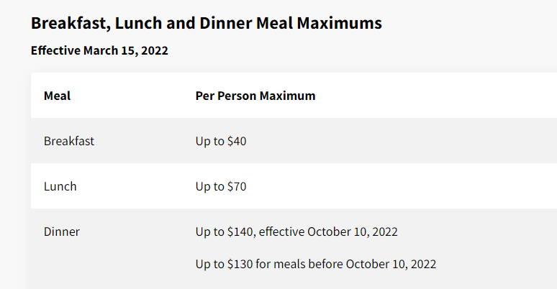
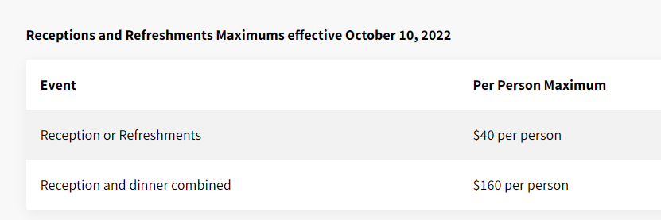
Updated Meal Limits

Slide 4
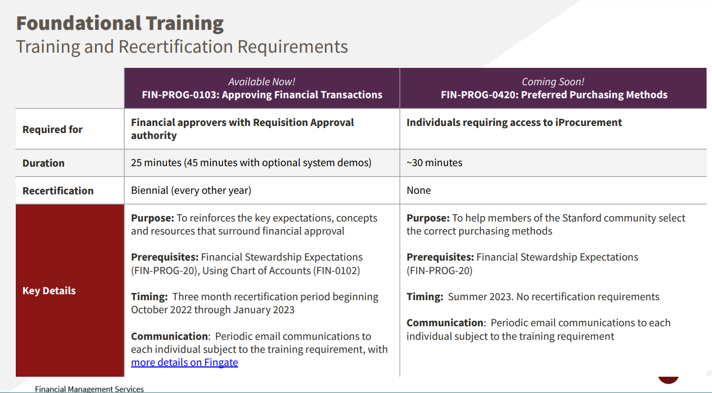

Slide 5
Cash and Check Process Change
No CASHNet starting Nov. 23rd and no deposits between Nov 23-Nov 30. Continue to email paymentsoffice@lists.stanford.edu. Changes have been communicated to users. Cash and Check Enhancement Info Session on Wednesday, November 10 from 10 to 11 a.m.

Slide 6
https://fingate.stanford.edu/receipts-gifts/resource/types-university-receipts

Slide 7
Vendor Services - New resources and guidance published on Fingate
Best practice is to have plenty of lead time, provide detailed information, and work closely with the supplier
Refer to Topic Overview: Setting Up a New Supplier or Payee to learn about the supplier setup process.

Slide 8
Backup Slides

Slide 9
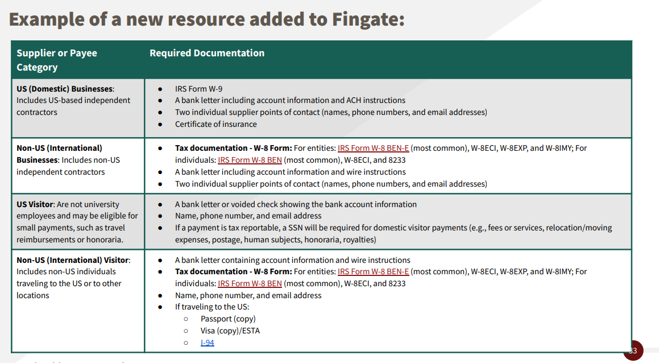
Vendor services - new resources and guidance

