Slide 1
VPDoR Finance Update
August 2023

Slide 2
Topics
FY23 yearend close
Medical wavers
Changes to card suspension process
Living wage fees
Funds management courses in November

Slide 5
FY23 YEC Resources
Recording all expenses
To find pending transactions that need to be completed, use aging reports: Expense Requests - Aging, Credit Card Transactions - Aging, and Advances - Aging.
To find invoices that are on hold or aging and need action before they can post to a PTA, use Procure to Pay at a Glance.
Additionally, processors and approvers can use the Oracle Financials Inquiry Tool: Pending Transactions to both see the status of and, in some instances, take action on pending transactions.
How To: Clear Organization Suspense Accounts for Labor provides instructions on how to find and clear organization suspense accounts. The final pay period payroll data is available for reporting and labor distribution adjustments (LDAs) starting Sunday, Sept. 3, 8 a.m. LDAs must be submitted and approved by Wednesday, Sept. 6, 5 p.m.
  To monitor and review the status of LDAs, run the report Labor Distribution Adjustments (Real-time).
Stanford Financial Management Services

Slide 6
FY23 YEC Resources
Managing funds
Fund Statement helps monitor available balance to find awards that are in overdraft, especially cost shares which need clearing.
Transfer Detail Report shows the transfers to and from your awards. Enter AUG-YYYY for both Beginning and Ending Period to limit to August only transfers.
Budget Variance helps compare actuals with expected amounts for both revenue and expense to suggest variances for investigation.
Inactive Awards Report shows unused funds, while Unused and Underwater Endowment Funds Dashboard identifies endowments that are underutilized and building up balances or underwater and unavailable to be used.
Schedule delivery of BI Publisher reports
OBI How To Guide: Scheduling BI Publisher Report Jobs provides step-by-step instructions to receive BI Publisher reports, such as the Fiscal to Date Fund Statement (Current year and prior year only) (153A) and Monthly Expenditure Details Statement (285), via email at the frequency you prefer – daily, weekly, or on a specific date and time.
Stanford Financial Management Services

Slide 7
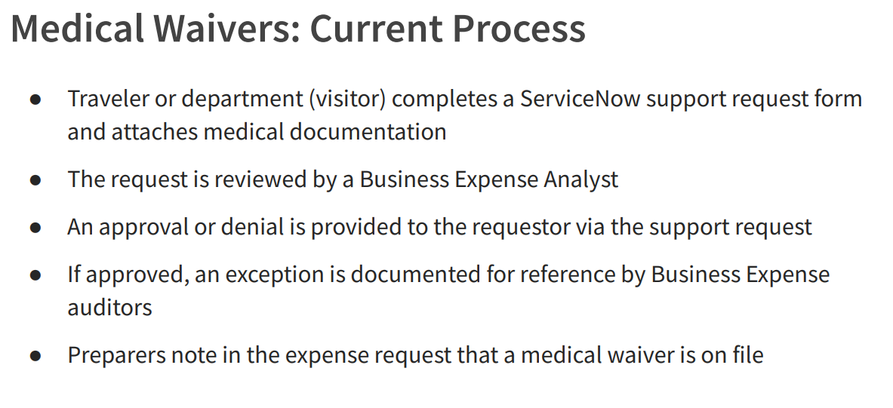
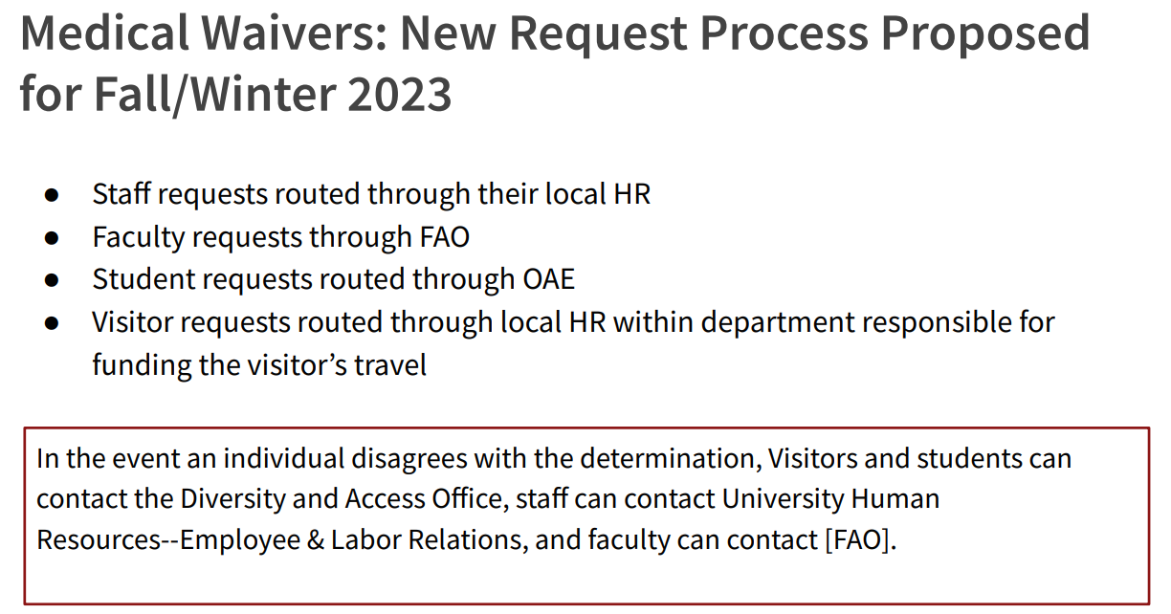
Notes:
To comply with confidential medical records requirements the Diversity and Access Office proposes that Stanford faculty, staff, student and visitor medical waiver requests are routed through the appropriate channels for approval Benefits include: ● Compliance with confidential medical records requirements ● Ease of access by requesters ● Convenience and efficiency of one-time approval for people with long term and chronic disabilities and/or conditions
Office of Accessible Education (OAE)

Slide 8
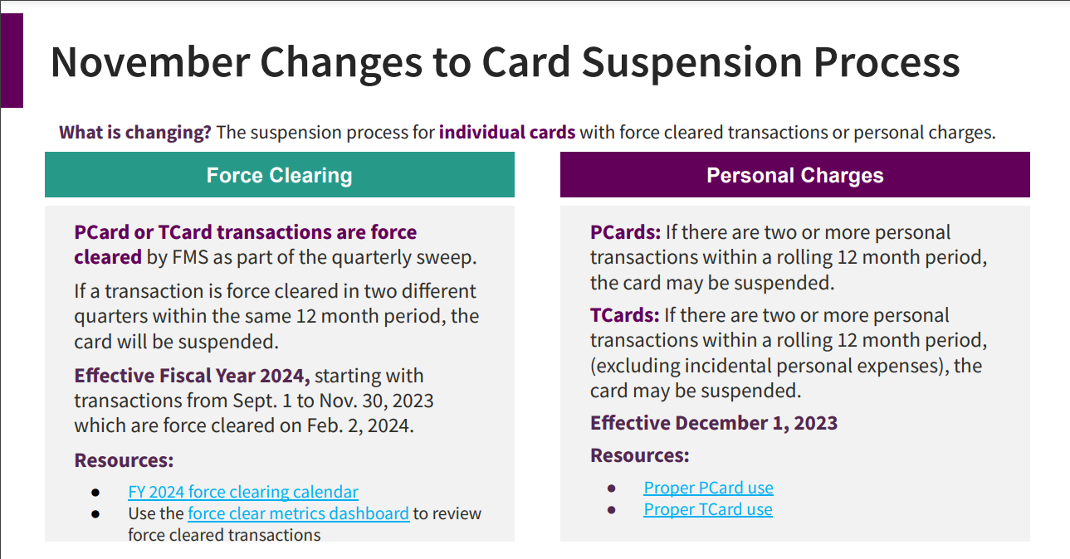

Slide 9
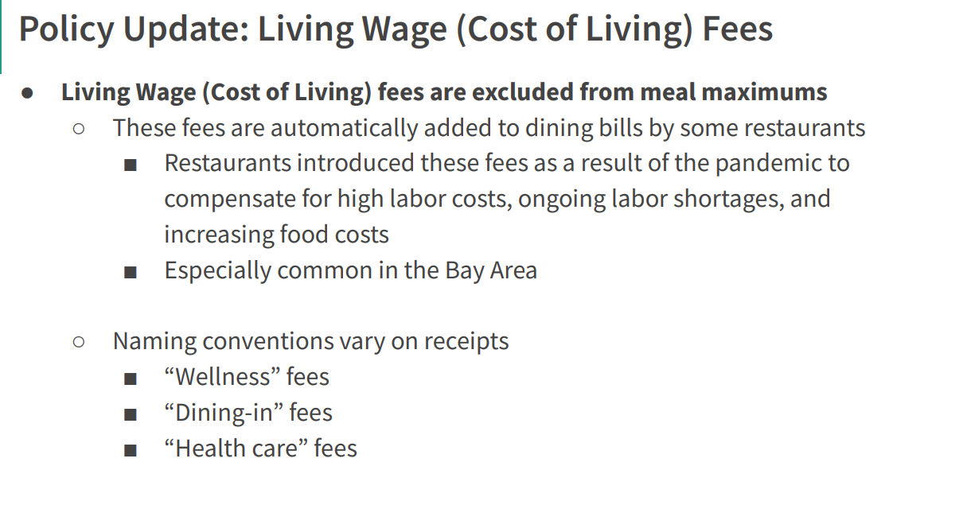

Slide 10
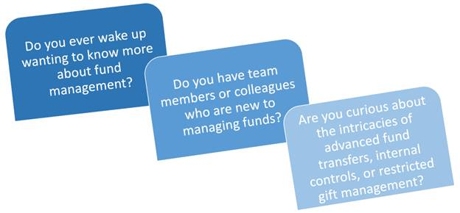
Funds Management Courses
Group interaction with our awesome Fund Accounting team
Q&A opportunities
With a class size limit for each class, please sign up as early as possible to ensure your spot

Slide 11
Funds Management Courses

